Slide 1
Notes:
http://www.bsidesdc.org/
Brian Martin – BSidesDC – October, 2014

Slide 2
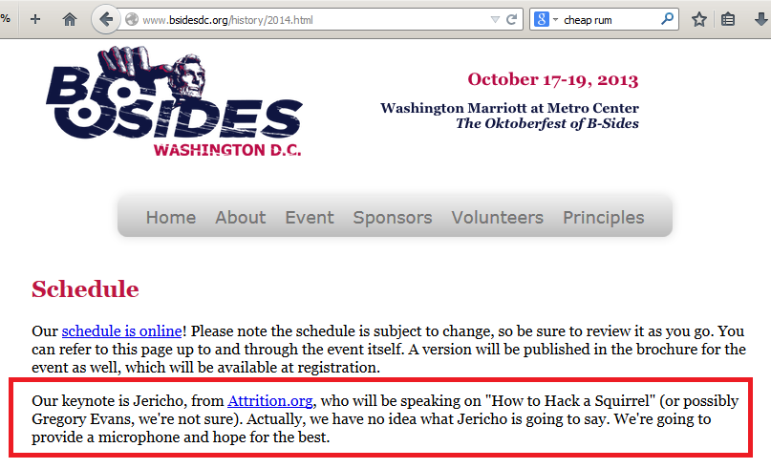
Notes:
So they tell me this is a keynote, which is new for me. You get to witness me losing my keynote virginity. Maybe I just stick with what they put on the page…

Slide 3
Notes:
Ok, joking aside..
“As the schedule says, this talk will cover "How to Hack a Squirrel”. Actually, we have no idea what Jericho is going to say. We're going to provide a microphone and hope for the best.”
Image source: http://gandtblog.com/blog/do-not-panic-it-is-all-under-control/

Slide 4
Notes:
As mentioned, this is a keynote, which is new for me. As someone skeptical of, and unhappy with keynotes I have attended, this is certainly a challenge. My first thought was, "what the hell did I agree to?!"

Slide 5
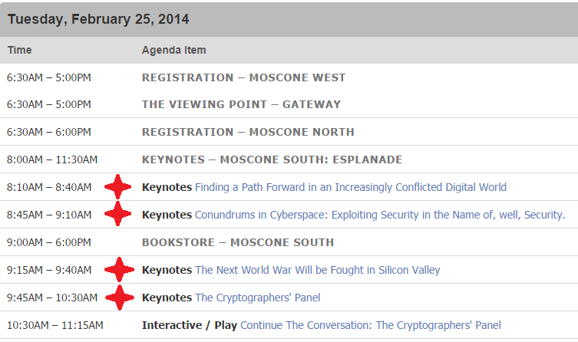
Notes:
My second thought was, "wait... what makes a keynote exactly?“ Consider that RSA had 16 keynotes this year across 4 days and it makes it seem like any other talk. And one of them was a panel?!
RSA had 16 keynotes this year
Feb 25 @ RSA:
8:10AM – 8:40AM Keynotes Finding a Path Forward in an Increasingly Conflicted Digital World
8:45AM – 9:10AM Keynotes Conundrums in Cyberspace: Exploiting Security in the Name of, well, Security.
9:15AM – 9:40AM Keynotes The Next World War Will be Fought in Silicon Valley
9:45AM – 10:30AM Keynotes The Cryptographers' Panel
Feb 26 @ RSA:
2:20PM – 2:50PM Keynotes The FBI and the Private Sector: Closing the Gap in Cyber Security
2:50PM – 3:15PM Keynotes Stop Looking for the Silver Bullet: Start Thinking Like a Bad Guy
3:15PM – 3:40PM Keynotes Operation Full Circle
3:40PM – 4:05PM Keynotes The Future of Security
4:05PM – 4:50PM Keynotes The Boy Who Played with Fusion
Feb 27 @ RSA:
2:20PM – 3:05PM Keynotes Little Bets: How Breakthrough Ideas Emerge from Small Discoveries
3:05PM – 3:30PM Keynotes The New Model of Security
3:30PM – 3:55PM Keynotes The Cloud – Security Nightmare or Our Next Great Hope?
3:55PM – 4:20PM Keynotes State of the Hack: One Year after the APT1 Report
4:20PM – 5:05PM Keynotes The Story of charity: water
Feb 28 @ RSA:
1:00PM – 1:45PM Keynotes Hugh Thompson and Guests
1:45PM – 2:35PM Keynotes Remarks by Stephen Colbert

Slide 6
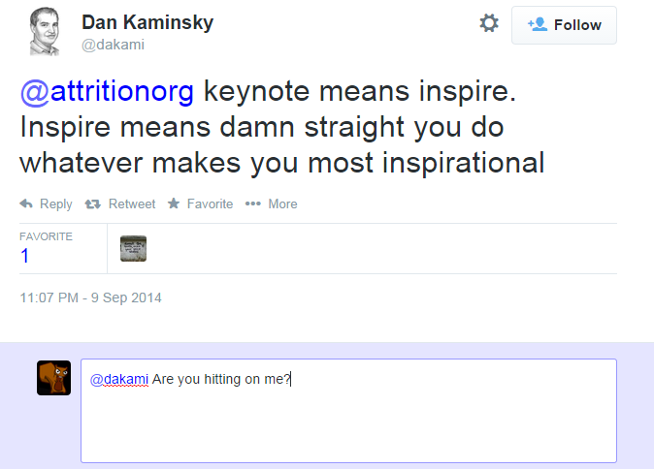
Notes:
So I had to ask the Twitters, "what do you expect out of a keynote?" One reply said that it should explain why security matters. Another said they want a different and broader perspective.
https://twitter.com/dakami/status/509568759527251968

Slide 7
Notes:
One honest reply said "a good seat for whatever talk comes after the keynote in that room".
Image source: https://twitter.com/kickfroggy/status/516332373953507328 / http://twitpic.com/ec7090 (DerbyCon 2014)

Slide 8
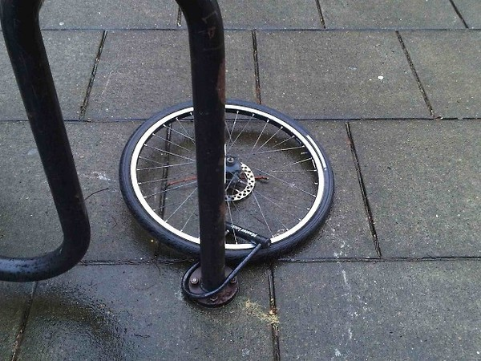
Notes:
I was told it should propose solutions, not more of "you are doing it wrong".
Image source: http://www.choppedliverroadkill.com/?author=0&paged=35 (and others)

Slide 9
Notes:
Yet another said it should contain stories that relay relevant experience.
Book: http://smile.amazon.com/exec/obidos/ISBN=0547429223/insekurityorgA/

Slide 10
Notes:
A few people said it should set the tone of the conference, but I don't think that can be done for a multi-discipline conference. First, the CFP selection happens months before a keynote is selected sometimes. Second, a conference that covers as many topics and represents activity that can be used for good or bad, what is the tone exactly?
x

Slide 11
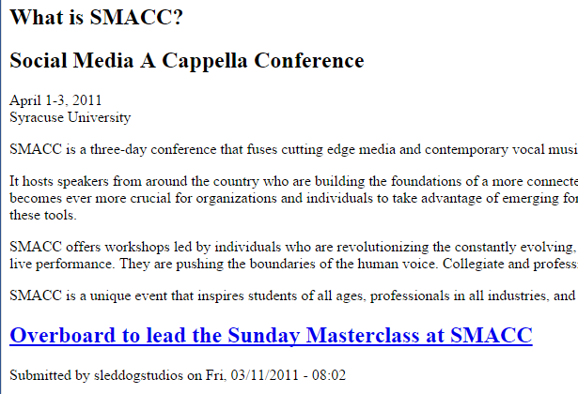
Notes:
Unless the con is very specifically focused, not sure you can “set the tone” really.
http://www.smacconference.com/ (now 404 sadly)

Slide 12
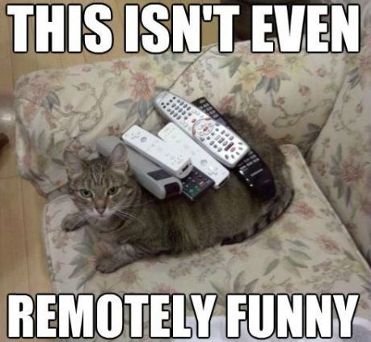
Notes:
I had to ask if keynotes used slides even, as most I can recall did not. I was told that yes they do, which was a welcome relief as they are my crutch. If my words bore you, at least you get funny pictures.

Slide 13
Notes:
I am not much of a motivational speaker and a keynote is an incredible responsibility. Let me emphasize that, a keynote is an INCREDIBLE RESPONSIBILITY.
x

Slide 14
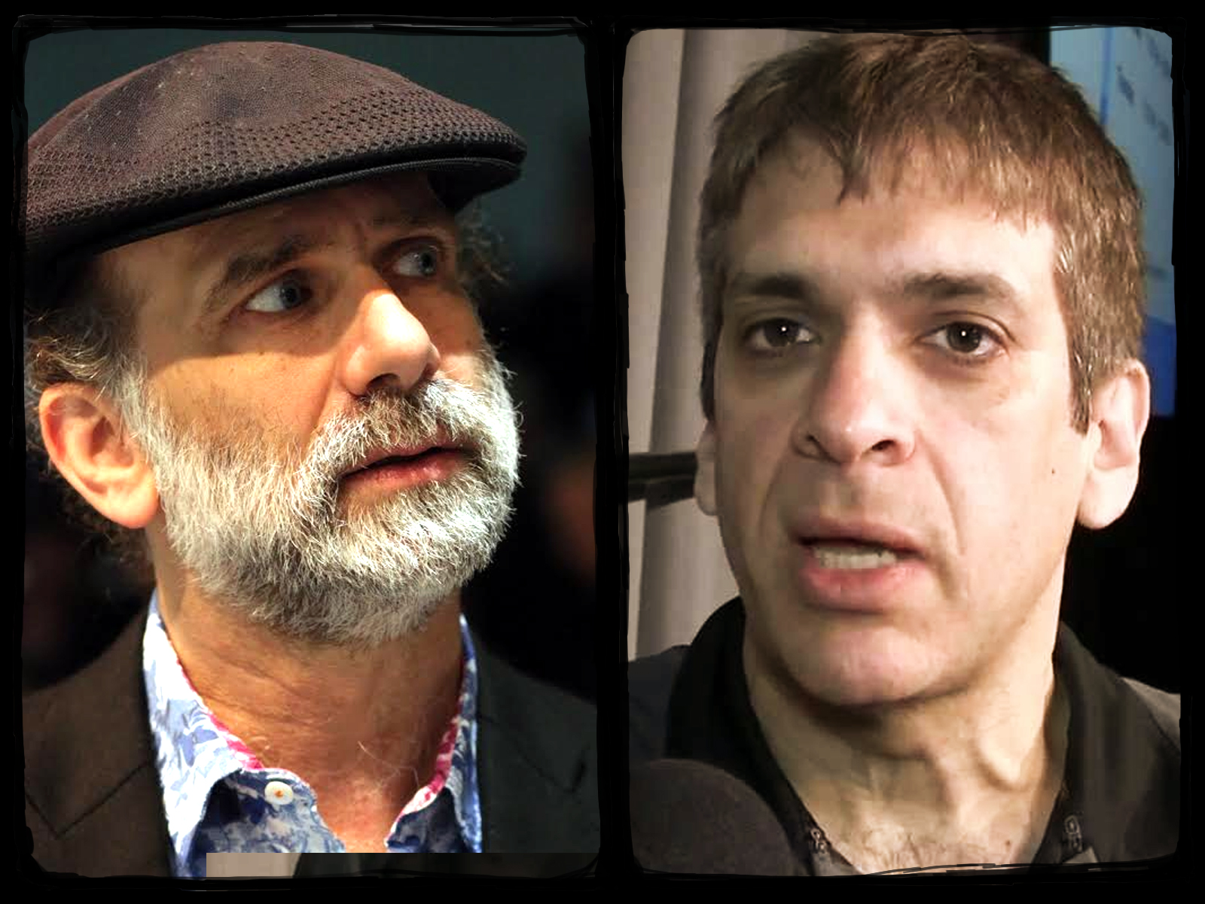
Notes:
Unfortunately many keynote speakers don't seem to think of it that way, instead they think of themselves, appearances, and money. If you didn't know, some of the popular names you see giving keynotes at security conferences charge as much as 15k and deliver mediocrity. Those same people don't deliver regular presentations at other conferences. They don't speak and impart their knowledge because they like to. To me, those are the talks to walk away from.
(Since you are probably wondering, I received 3 nights at the con hotel for presenting, courtesy of BSidesDC.)

Slide 15
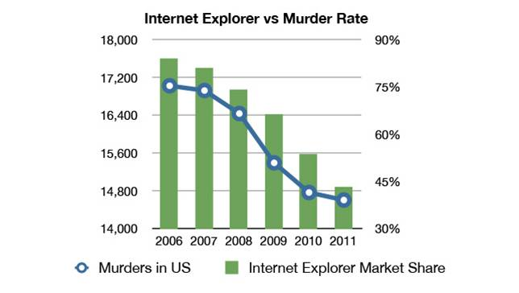
Notes:
How many big conference keynotes tell you anything new or different? We all know security is needed and the state of affairs is 'bad', but most can't even qualify it other than a few high level stats that are anecdotal at best. Does that seem right to you?
All hail Jubal Early! (Google it)

Slide 16
Notes:
Let’s start with the status of security?
x

Slide 17
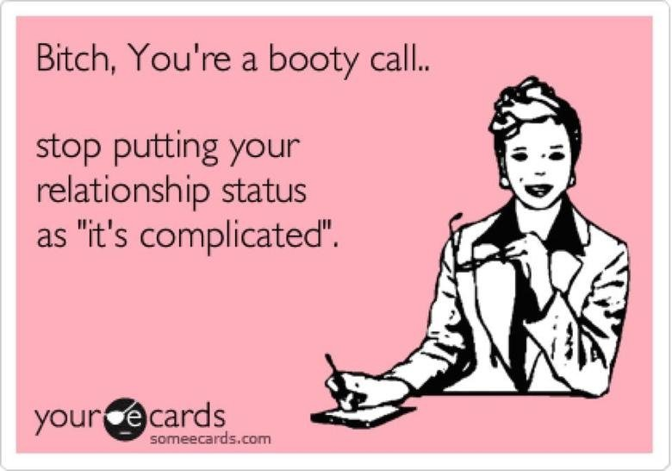
Notes:
So what is the status of InfoSec…
x

Slide 18
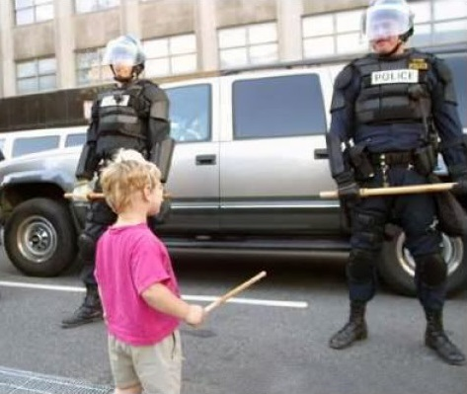
Notes:
While we know security is bad, I don't think the industry as a whole fully understands or accepts what we're up against.
x

Slide 19
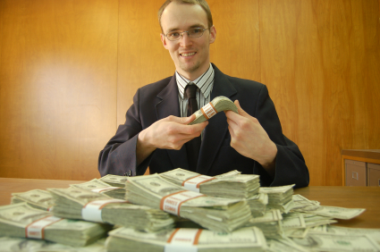
Notes:
Do we know that companies, some claiming to help you become more secure, are actively working against their clients in the name of saving a few bucks? And this is happening at scale, not a rare one-off situation.
x

Slide 20
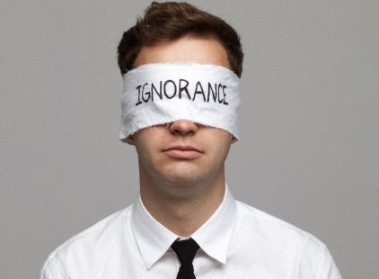
Notes:
Multi-million dollar companies that balk at inexpensive solutions and then say the scariest thing I have heard in twenty years of InfoSec. "Our customers aren't asking for better." Of course not you idiots! You aren't telling them that better is out there when you know it is, and they don't know what to ask for. That is why they hired you!
x

Slide 21
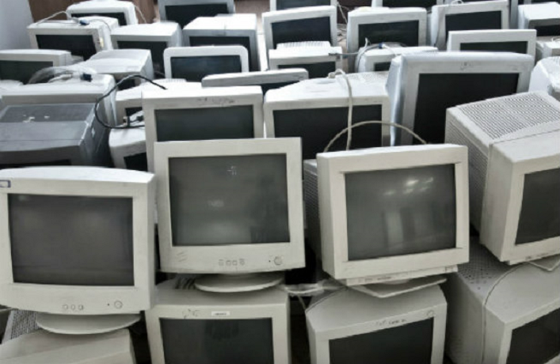
Notes:
We're up against hundreds of millions of devices that aren't patched on time and never will be.
x

Slide 22
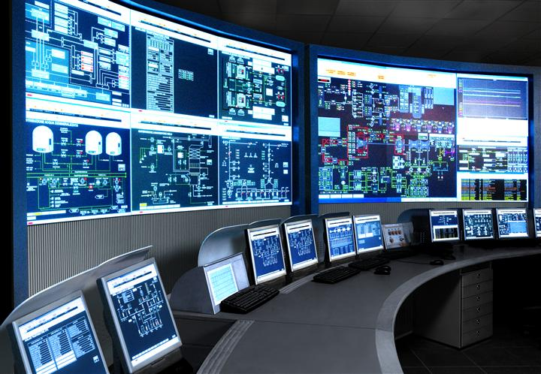
Notes:
We have to consider millions of devices that can't be patched at all, some running critical systems. Oh, that it SCADA.
X

Slide 23
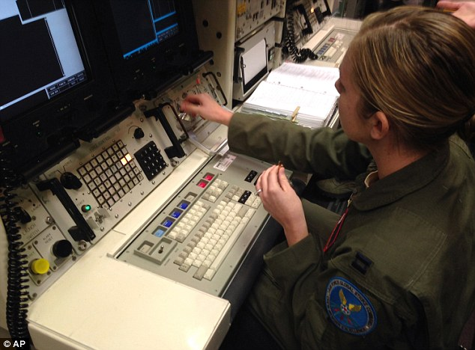
Notes:
And that is a female in technology, ready to launch a nuclear missile from a computer that probably cant be updated.
x

Slide 24
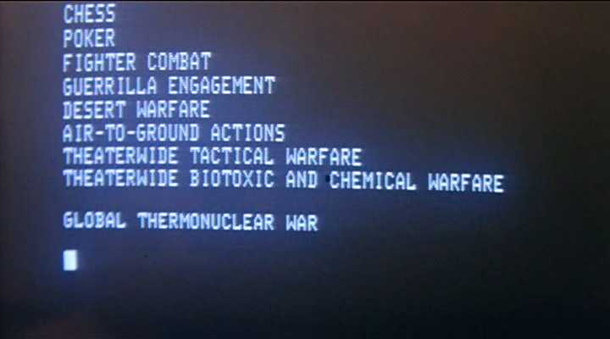
Notes:
I was going to use this screenshot for the last, but realized that some of my audience may not be a decrepit run-down geezer.
x

Slide 25
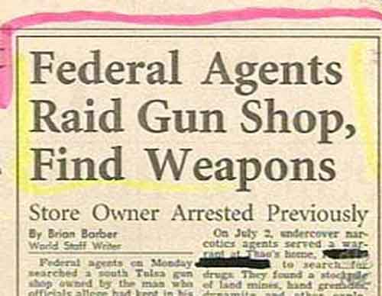
Notes:
We have to understand the financial reward for doing bad things is greater than the punishment because law enforcement is woefully behind. When they are up on technology and techniques, and some are, they are seriously outnumbered and have little budget.
x

Slide 26
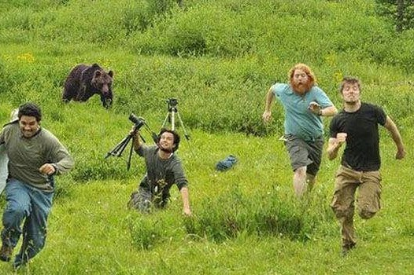
Notes:
The old adage of running faster than your friends when the bear comes basically holds true regarding law enforcement. Bad guys only have to be a bit smarter, or in a better jurisdiction than their peers. Law enforcement can spend a year investigating a single intrusion, or a series of them from a single bad actor.
x

Slide 27
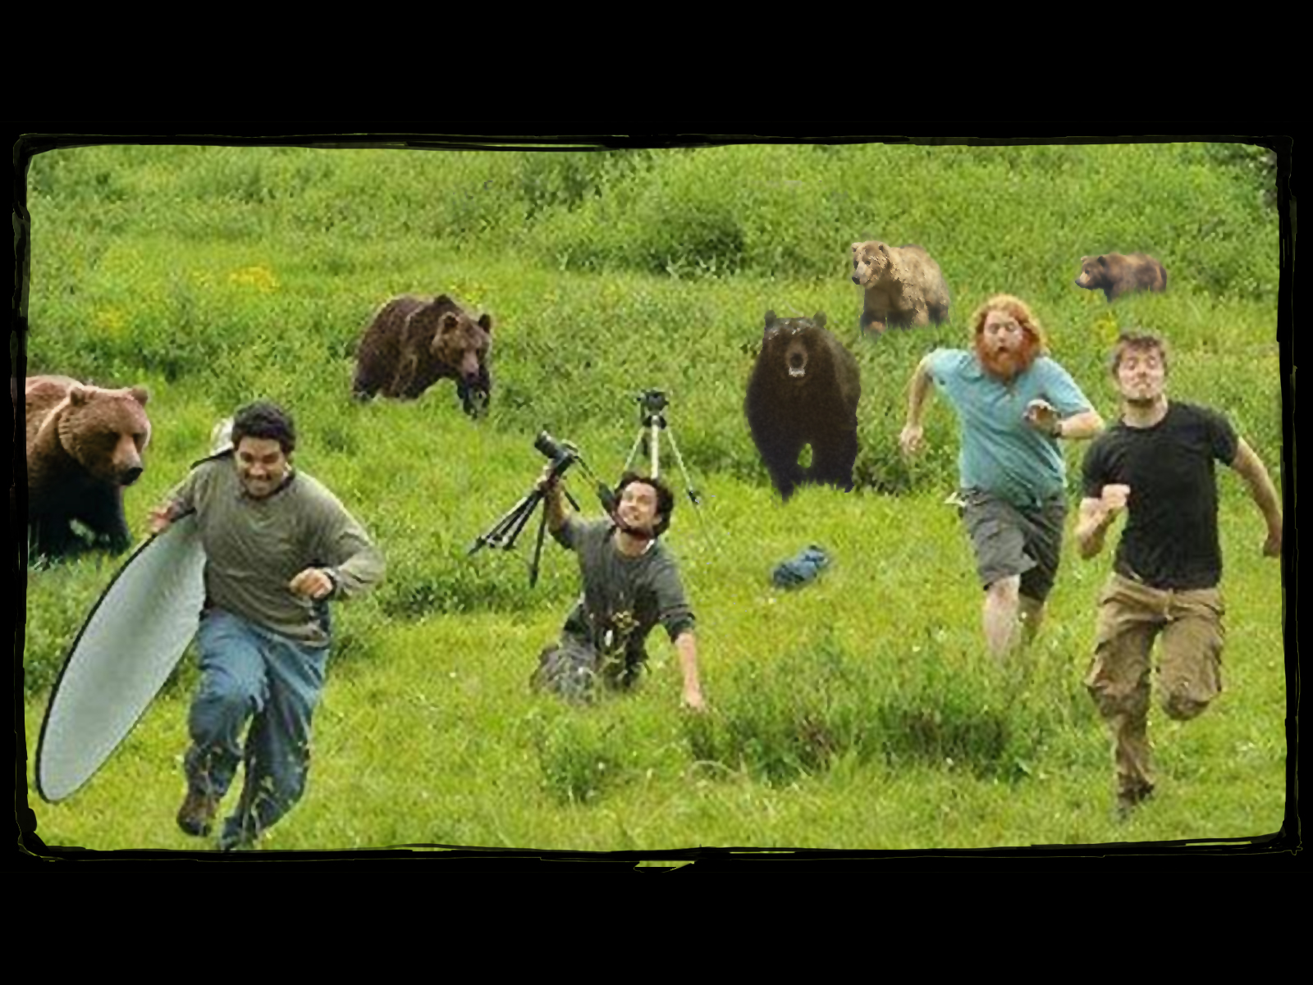
Notes:
But for the average company, that adage is used over and over again, and dead wrong. You have to be more secure than the other guy to be safe! Which is complete bullshit. There are too many bears in these woods.
x

Slide 28
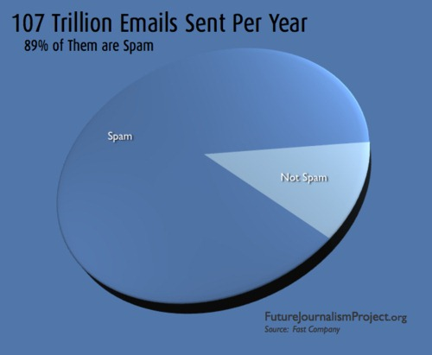
Notes:
There are likely tens, maybe hundreds of thousands of bad actors out there doing cutting edge attacks, and in the last 40 years we still haven't figured out solutions to spam...
x

Slide 29
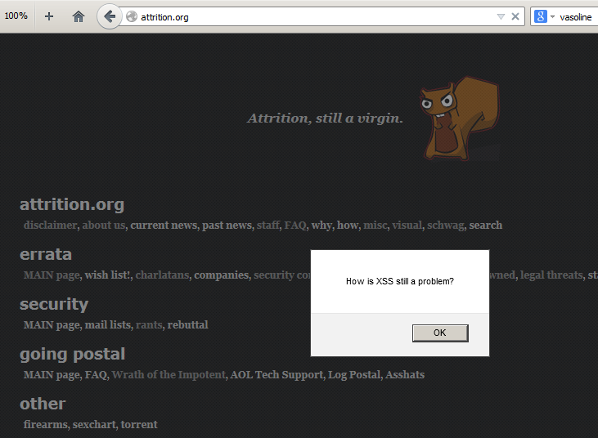
Notes:
... we still don't use secure programming languages to help save developers from themselves, and us.
x

Slide 30
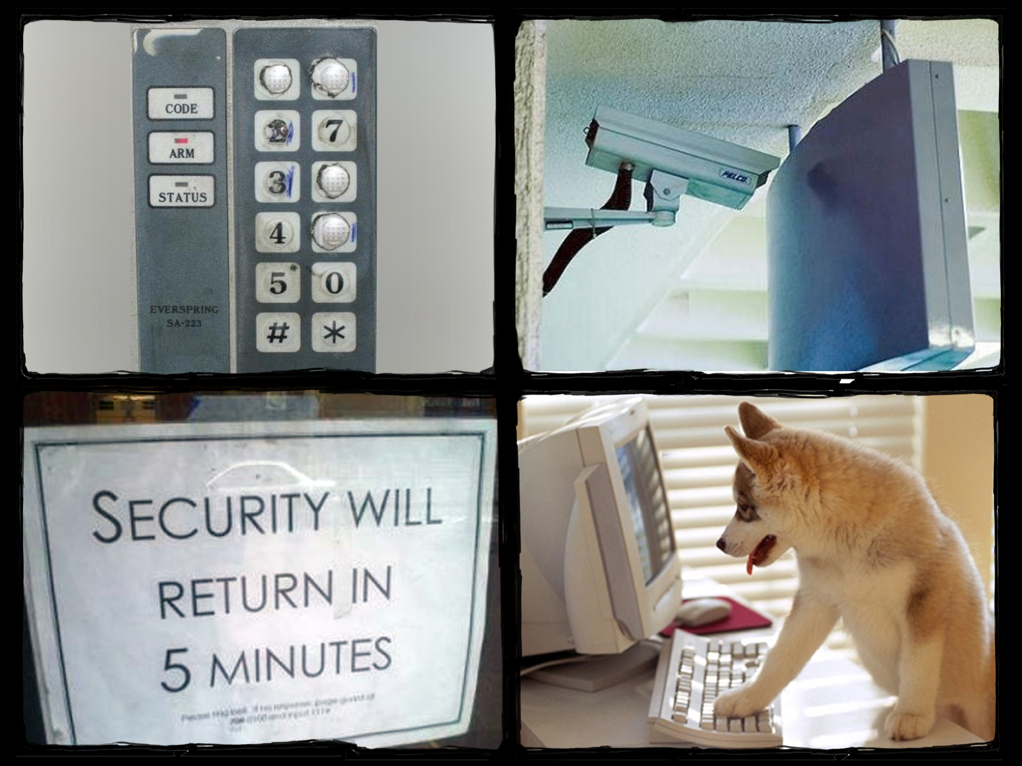
Notes:
Everything is working against us. We see worn keypads, security deployment fail, people that click shit, and a general lack of understanding.
x

Slide 31
Notes:
We have devs that have no incentive to think about security, no executive buy-in on security programs, software meant to protect us that only adds vulnerabilities, and widely accepted standards that are barely the 'no server left behind' of security.
x

Slide 32
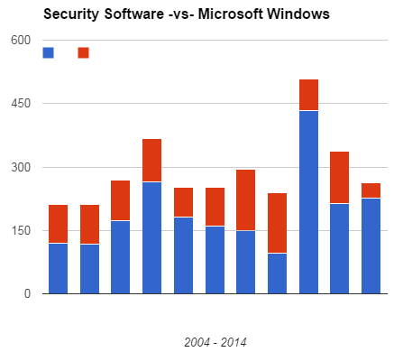
Notes:
Speaking of security software that is supposed to protect us, approximately 2% of disclosed vulnerabilities are in security products themselves. Compare that to Microsoft Windows, in blue.
X
Yes, this is essentially lying with stats, oh the irony! Since I called out vuln stats with Steve Christey at BlackHat in 2012, I know this may be misleading. Users of Windows do not install every piece of security software out there, but it still illustrates the point that security software, designed to protect you, is worse than the state of Windows, long known for being vulnerable.

Slide 33
Notes:
As an industry we talk about understanding hackers and thinking like them yet we continue to provide degenerate solutions that show no understanding of it such as IP-based threat intelligence that is not intelligent...
x

Slide 34
Notes:
... and dataloss protection (DLP) that doesn't seem to work …
x

Slide 35
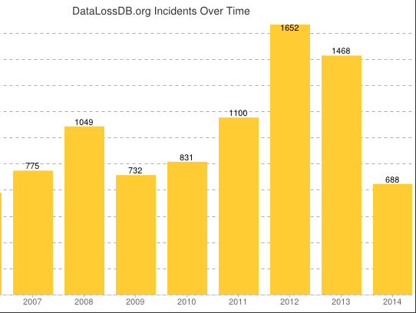
Notes:
... to have helped the 13,195 documented breaches on record.
(https://cyberriskanalytics.com/pages/statistics).

Slide 36
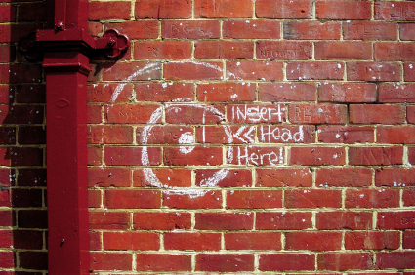
Notes:
There has to be a way to improve this dismal track record and actually improve security, right?
x

Slide 37
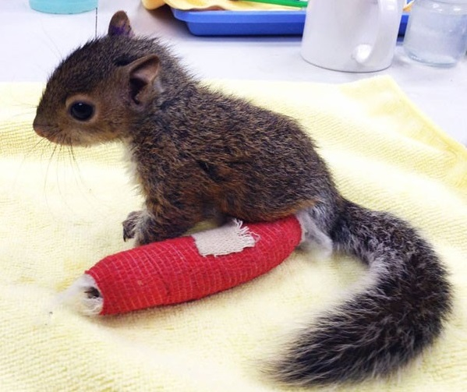
Notes:
If not, then we should throw in the towel and all go volunteer at our favorite shelters, be it animal or human.
http://www.today.com/pets/adorable-baby-squirrel-wears-cast-broken-ankle-1D79545444

Slide 38
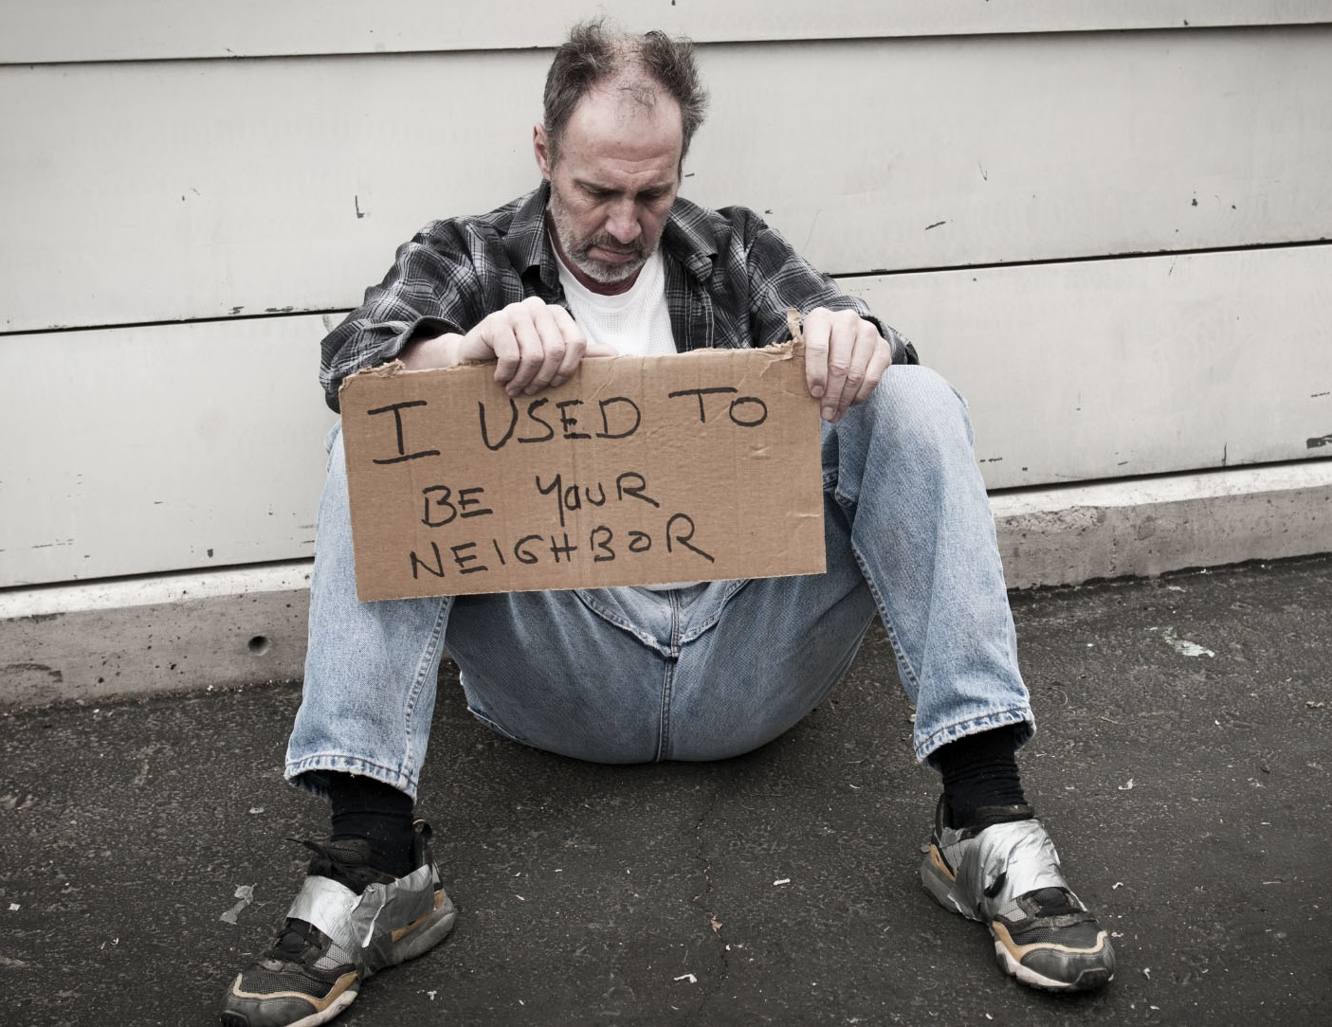
Notes:
Photo courtesy of bohocommunity.org

Slide 39
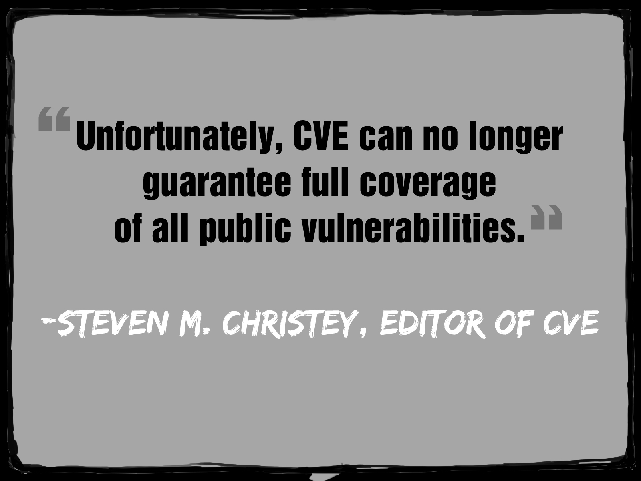
Notes:
Don’t agree? Others have already thrown in the towel and given up. Unfortunately for our industry, they are sometimes a cornerstone of security and the basis of products and services everywhere. This was said March 20, 2013. All those firewalls, IDS, IPS, vuln alerting services, vuln stats , and more that are based on CVE… do you have any confidence in them? You shouldn’t, they are missing at least 32,689 vulnerabilities that I am aware of.
http://attrition.org/pipermail/vim/2013-March/002657.html

Slide 40
Notes:
At some point we have to reconsider our battle ground and come up with a new paradigm. Then we need to stop using ill-fitting military terms, industry buzz words, and just speak plainly. Else, this will become an integral part of our security offering.
x

Slide 41
Notes:
So a bit of perspective…
x

Slide 42
Notes:
So before we come up with that new paradigm (shit, drink again), we really need to get some grounded perspective on a few things that are hindering us from making positive change.
x

Slide 43
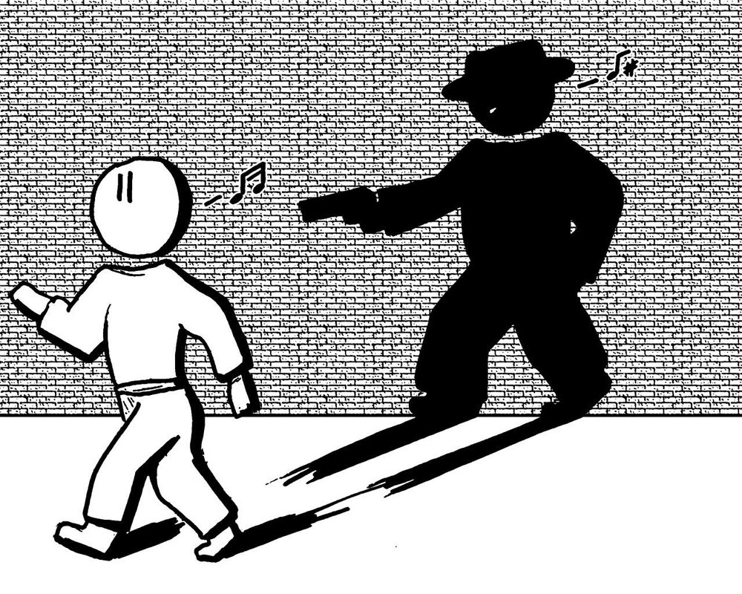
Notes:
In addition to that whole tirade about the bad guys and stupid users, we, the infosec industry, are our own worst enemy.
x

Slide 44
Notes:
Our intentions are usually the best, but as they say, the road to hell is paved with good intentions. There are a few things that our community is losing focus on and ultimately doing as much bad as good.
x

Slide 45
Notes:
Let's start with the impact of our work, specifically vulnerability research. Don't get me wrong, there is a lot of great research that is very important to the industry, consumers, and those we seek to protect.
Image source: http://blog.pistolstar.us/blog/

Slide 46
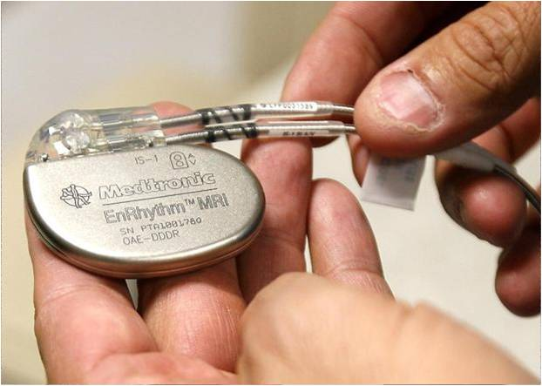
Notes:
A friend was at a security conference recently and she recalls how everyone was up in arms over devices like pacemakers and how they could be hacked, possibly leading to death.
x

Slide 47
Notes:
She looked around the room at people discussing it, many overweight and drinking high-calorie, high-carb, high-fat beverages. She asked, "heart disease kills more people than pacemaker hacks and is more easily prevented. why aren't you all focusing on that?" They thought her comment was "harsh", but i say it is realistic. As an industry we focus on the exotic because it is sexy and fun. We focus on "end of the world" and "zombie apocalypse" but ignore "heart attack because I ate too many cheeseburgers".
Venti ‘Java Chip’ with whipped cream = 570 calories, 93 carbs, 21g total fat

Slide 48
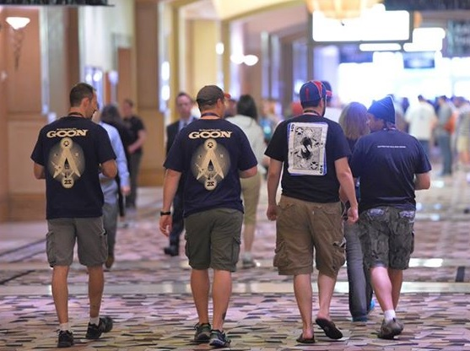
Notes:
About 600,000 people die of heart disease in the United States every year, which is 1 in every 4 deaths. Pick one.
Source: http://www.cdc.gov/heartdisease/facts.htm

Slide 49
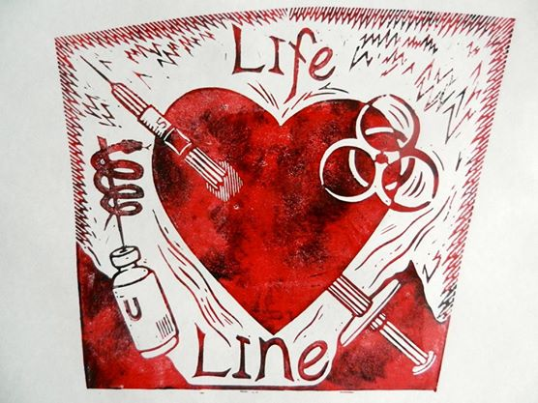
Notes:
Just over 234,000 death certificates listed diabetes as the underlying cause of death, or contributing cause of death, in 2010.
Image source: The Kwiatkowski Press, an incredible artist out of Denver.
https://www.facebook.com/pages/The-Kwiatkowski-Press/188895124490467?sk=photos_stream&tab=photos_stream
Information source: http://www.diabetes.org/diabetes-basics/statistics/ - Diabetes remains the 7th leading cause of death in the United States in 2010, with 69,071 death certificates listing it as the underlying cause of death, and a total of 234,051 death certificates listing diabetes as an underlying or contributing cause of death.
http://www.cdc.gov/nchs/fastats/diabetes.htm - Number of deaths: 73,831 (2011)

Slide 50
Notes:
Over 3,000 people were killed in 2012 due to crashes involving a distracted driver.
Information source: http://www.cdc.gov/motorvehiclesafety/distracted_driving/ - In 2012, 3,328 people were killed in crashes involving a distracted driver, compared to 3,360 in 2011. An additional, 421,000 people were injured in motor vehicle crashes involving a distracted driver in 2012, a 9% increase from the 387,000 people injured in 2011.1

Slide 51
Notes:
As many as 1,000 people die a year to Autoerotic Asphyxiation.
Information source: http://www.oddee.com/item_98002.aspx -- http://www.medicinenet.com/script/main/art.asp?articlekey=51776

Slide 52
Notes:
And deaths due to hacking pacemakers comes in at a resounding zero. Deaths due to hacking anything? Still zero. Let that sink in for a second and remind me again why we're so worried about pacemaker hacking? Don't stop doing that research for one second though! Just remember to keep your perspective, especially when talking to the media or non-security friends.
(although a few will argue there have been a handful of deaths due to hacking, I haven’t seen any evidence.)

Slide 53
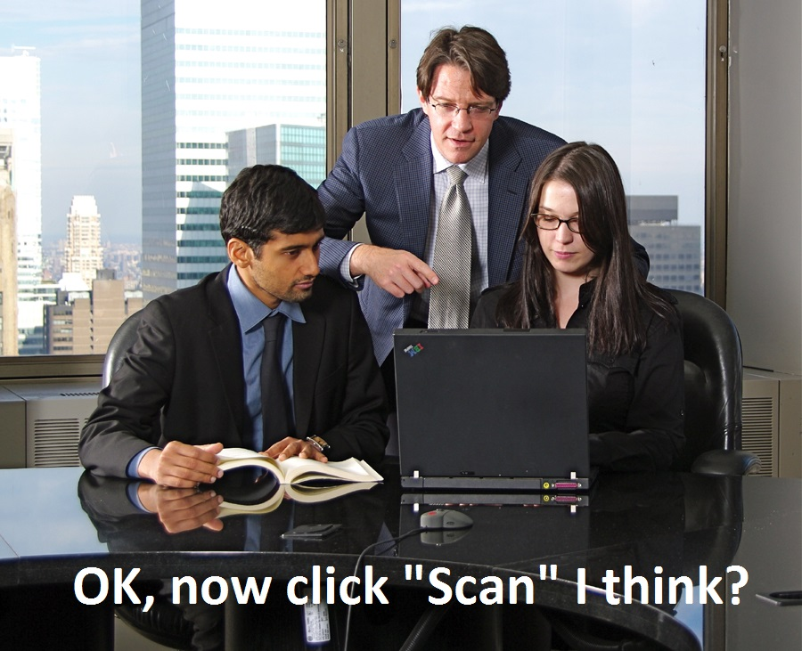
Notes:
The next thing we seem to be losing focus on is our desire to hire more security people. For several years we've heard about the increasing demand for security professionals.
http://www.computerworld.com/article/2495985/it-careers/demand-for-it-security-experts-outstrips-supply.html
http://www.scmagazine.com/skills-in-demand-information-security-analysts/article/346373/
http://www.csoonline.com/article/2365182/security-leadership/todays-top-skill-sets-in-security-and-why-theyre-in-demand.html

Slide 54
Notes:
We see longstanding certification bodies continue to push their oft-meaningless certifications, new certification bodies jump on this bandwagon with their own certs, and hundreds of 'bootcamps' that offer a quick path to getting certified.
x

Slide 55
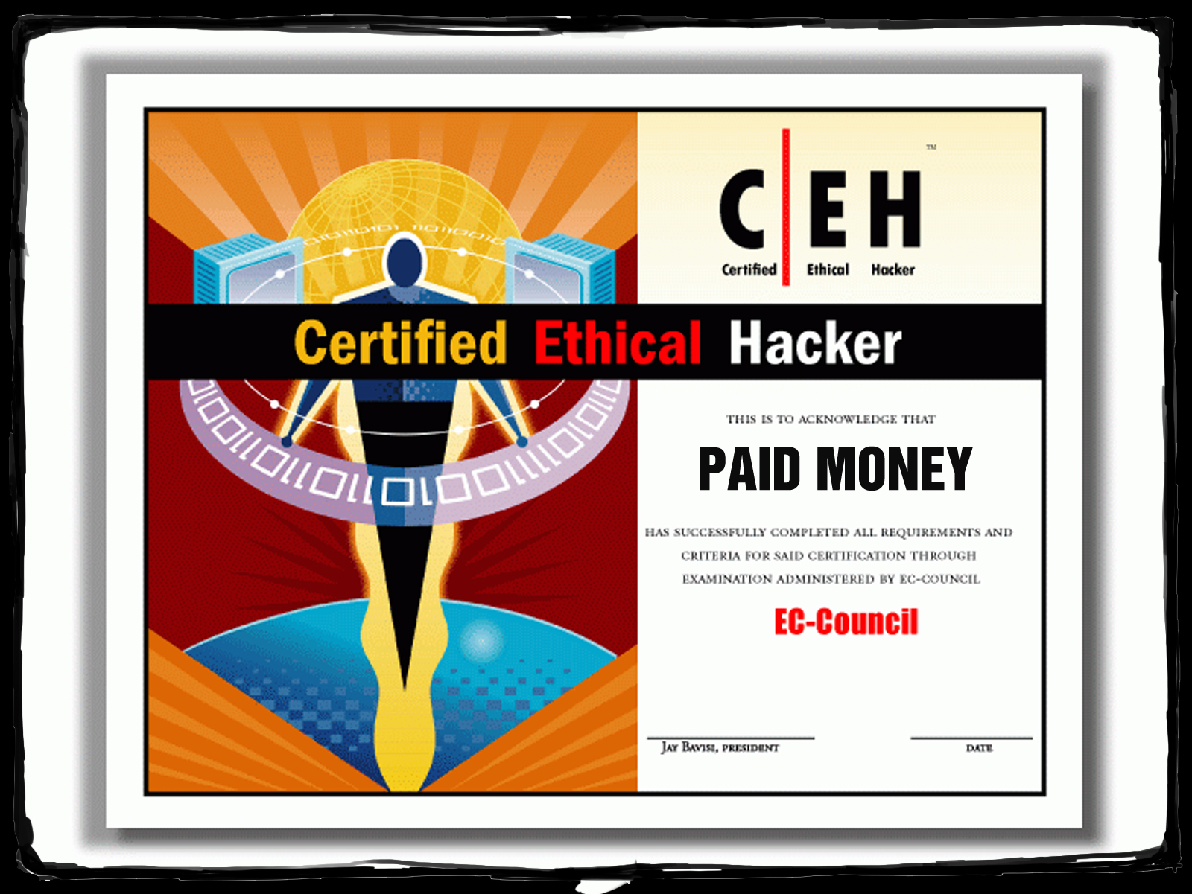
Notes:
Or for those lacking patience, you can just buy your certification outright from some bodies, according to rumors i've heard.
(I have heard this from enough reputable people over the years that I firmly believe this to be true.)

Slide 56
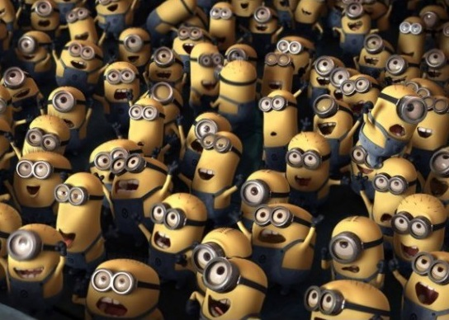
Notes:
Hiring more warm bodies won't help the security problem at all. In fact, it is likely to hurt us if anything.
x

Slide 57
Notes:
Even worse, we have a small amount of people in the industry that have gone overboard on demanding the warm bodies equally represent both genders. The arguments range somewhere between simple needed feminism and an irrational desire to have more women in the industry, qualifications be damned.
x

Slide 58
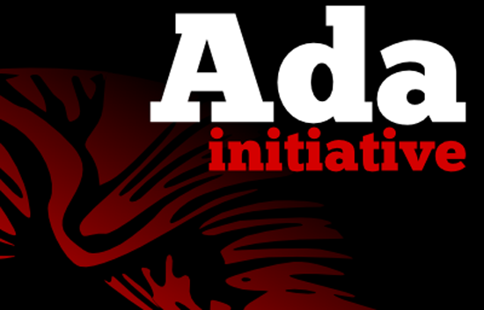
Notes:
In the process of lobbying for this, some of them (no names mentioned) are causing more drama and it is counterproductive to their goal. They seem to forget that there is a difference between being offended, and being harassed. In some cases, they actually manufacture drama at conferences to prove their point.
BSidesSF 2013 - http://adainitiative.org/2013/02/keeping-it-on-topic-the-problem-with-discussing-sex-at-technical-conferences/ -- http://violetblue.tumblr.com/post/44107008572/what-happened-with-my-security-bsides-talk -- http://slexy.org/view/s2uCMNmyPg -- http://jerichoattrition.wordpress.com/2013/03/25/a-holdout-for-sanity/

Slide 59
Notes:
I am sure we have no one in the audience that discriminates against women, or will admit to it. Yet it is serious ongoing problem because it definitely happens day to day, and in some recent cases in the gaming community, leads to death threats, threats of mass shootings, and more.
http://venturebeat.com/2014/08/27/critic-anita-sarkeesian-receives-online-death-threats-after-latest-feminist-frequency-video-on-games/
http://venturebeat.com/2014/10/10/game-developer-brianna-wu-leaves-home-after-receiving-death-threats-for-speaking-out-in-support-of-women/
http://www.washingtontimes.com/news/2014/oct/14/anita-sarkeesian-cancels-utah-university-lecture-a/

Slide 60
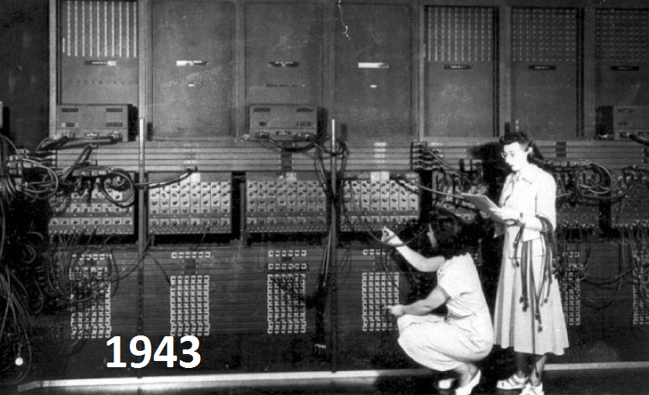
Notes:
To anyone discriminating against women for any reason, let me share with you a historical secret about women and technology. THEY HAVE BEEN DOING IT AS LONG AS MEN.
(6 more pics)
http://mic.com/articles/98382/17-rare-images-tell-the-real-story-of-women-in-tech
http://www.theguardian.com/lifeandstyle/2014/oct/13/ada-lovelace-day-women-computing-60s

Slide 61
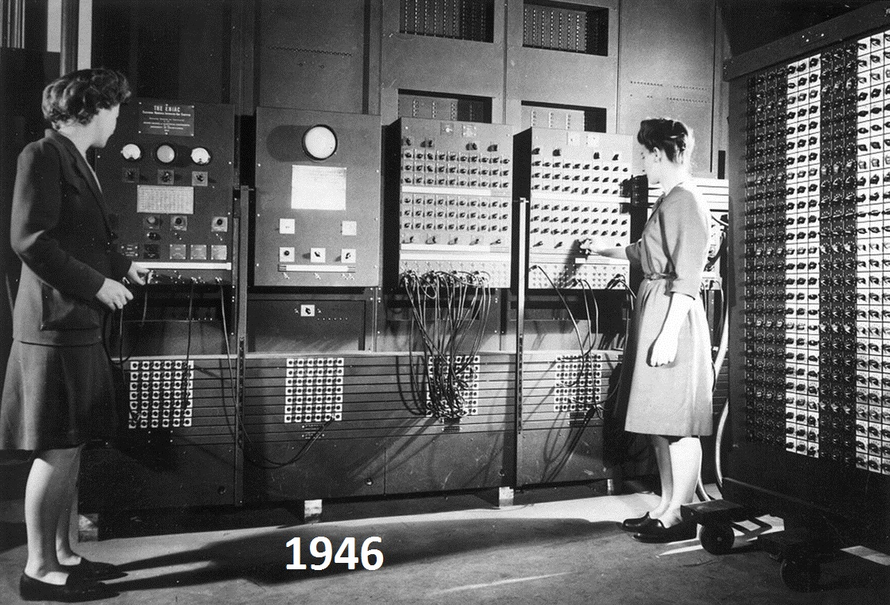

Slide 65
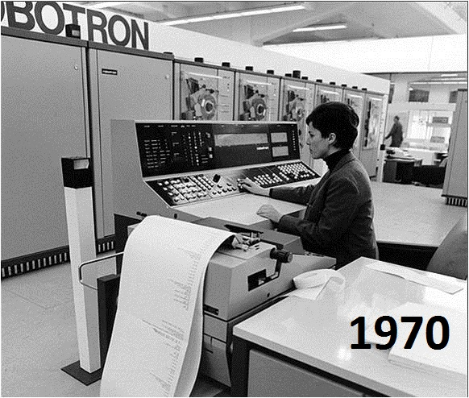

Slide 66
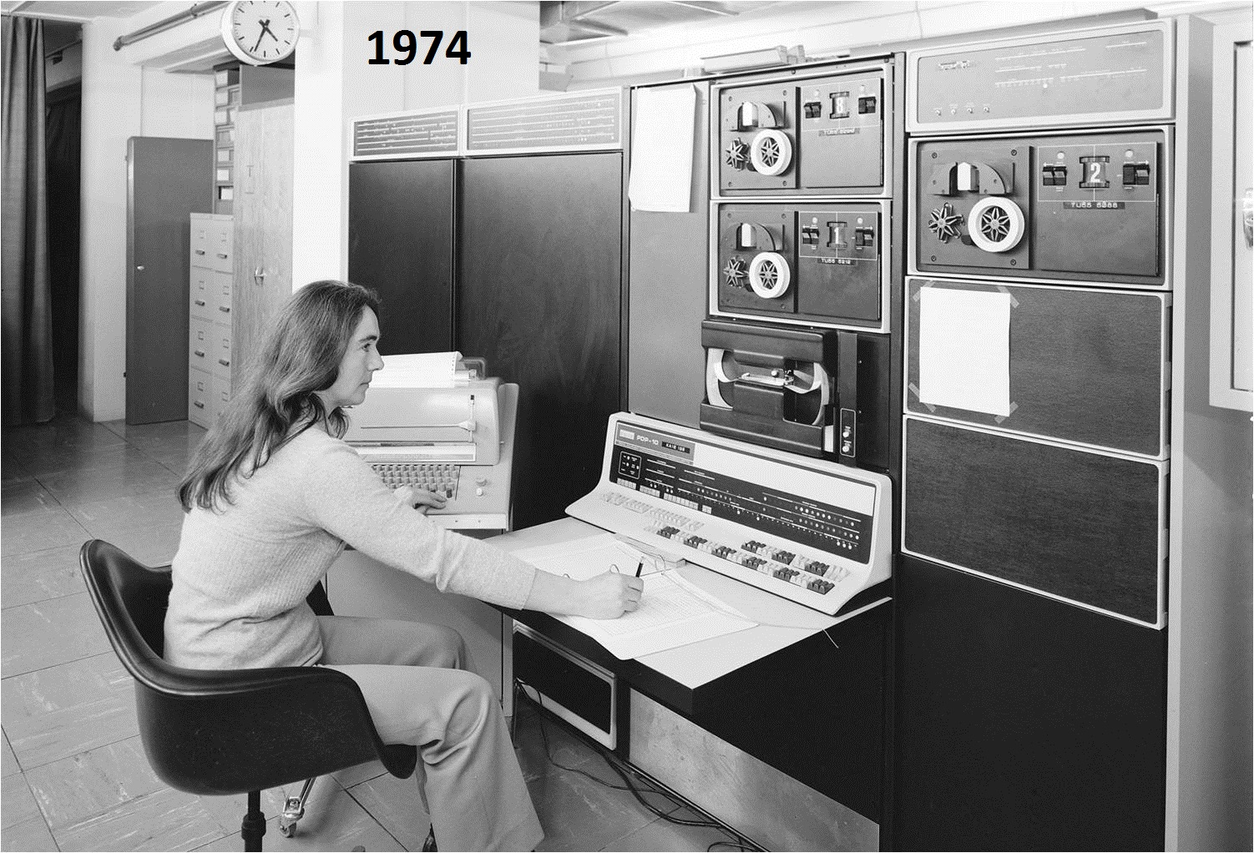
Notes:
Besides… if you really think that women have no place in tech, someone has a message for you.
x

Slide 67
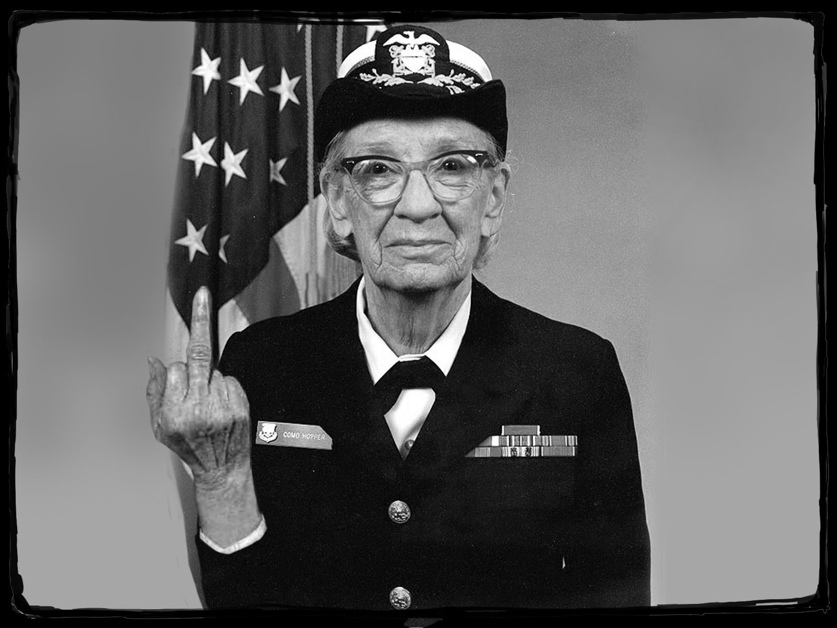
Notes:
Fuck you.
x

Slide 68
Notes:
How about as an industry we drop the gender and race argument and instead, we just treat everyone as a human for starters. I think if we can do that, and discriminate based on individual merit we'll see a steady uptick in females and diverse races joining our industry. More importantly, they will join to find it as welcoming as the next white guy currently enjoys. Qualified happy people will fix security, not warm bodies equally divided by race and gender meeting some imaginary quota.
x

Slide 69
Notes:
I'm told a keynote is meant to INSPIRE.

Slide 70
Notes:
But then people pointed out that it should be inspire in a GOOD way, and that is getting more difficult. That qualification is important since I, like many of you, am a career pessimist. After all, our industry is based on pointing out the negatives.
x

Slide 71
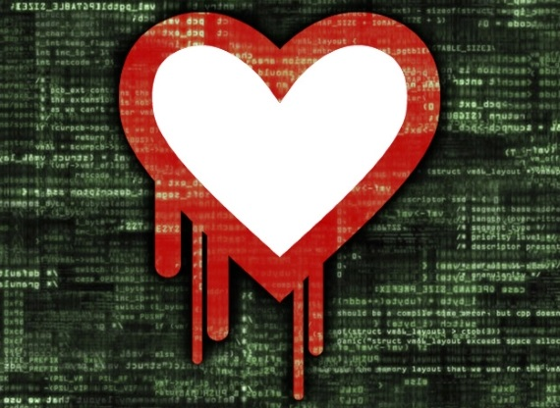
Notes:
Penetration tests show where security and admins fail. Audits show where we don't meet compliance. Vulnerability disclosure shows flaws in programmer's code.
x

Slide 72
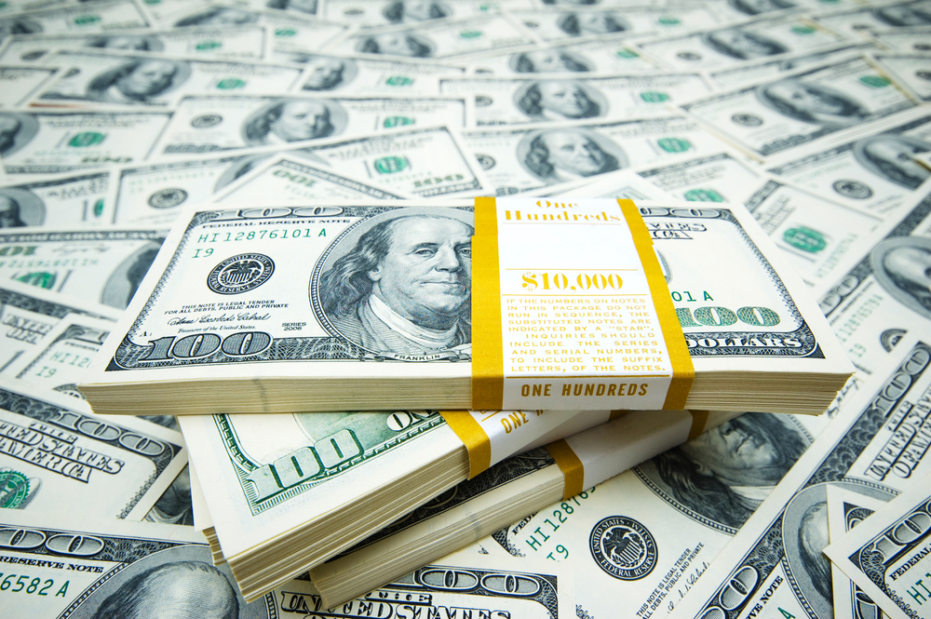
Notes:
That won't change unless we abandon our industry, and that will not happen because we all enjoy our job security and pay checks.
x

Slide 73
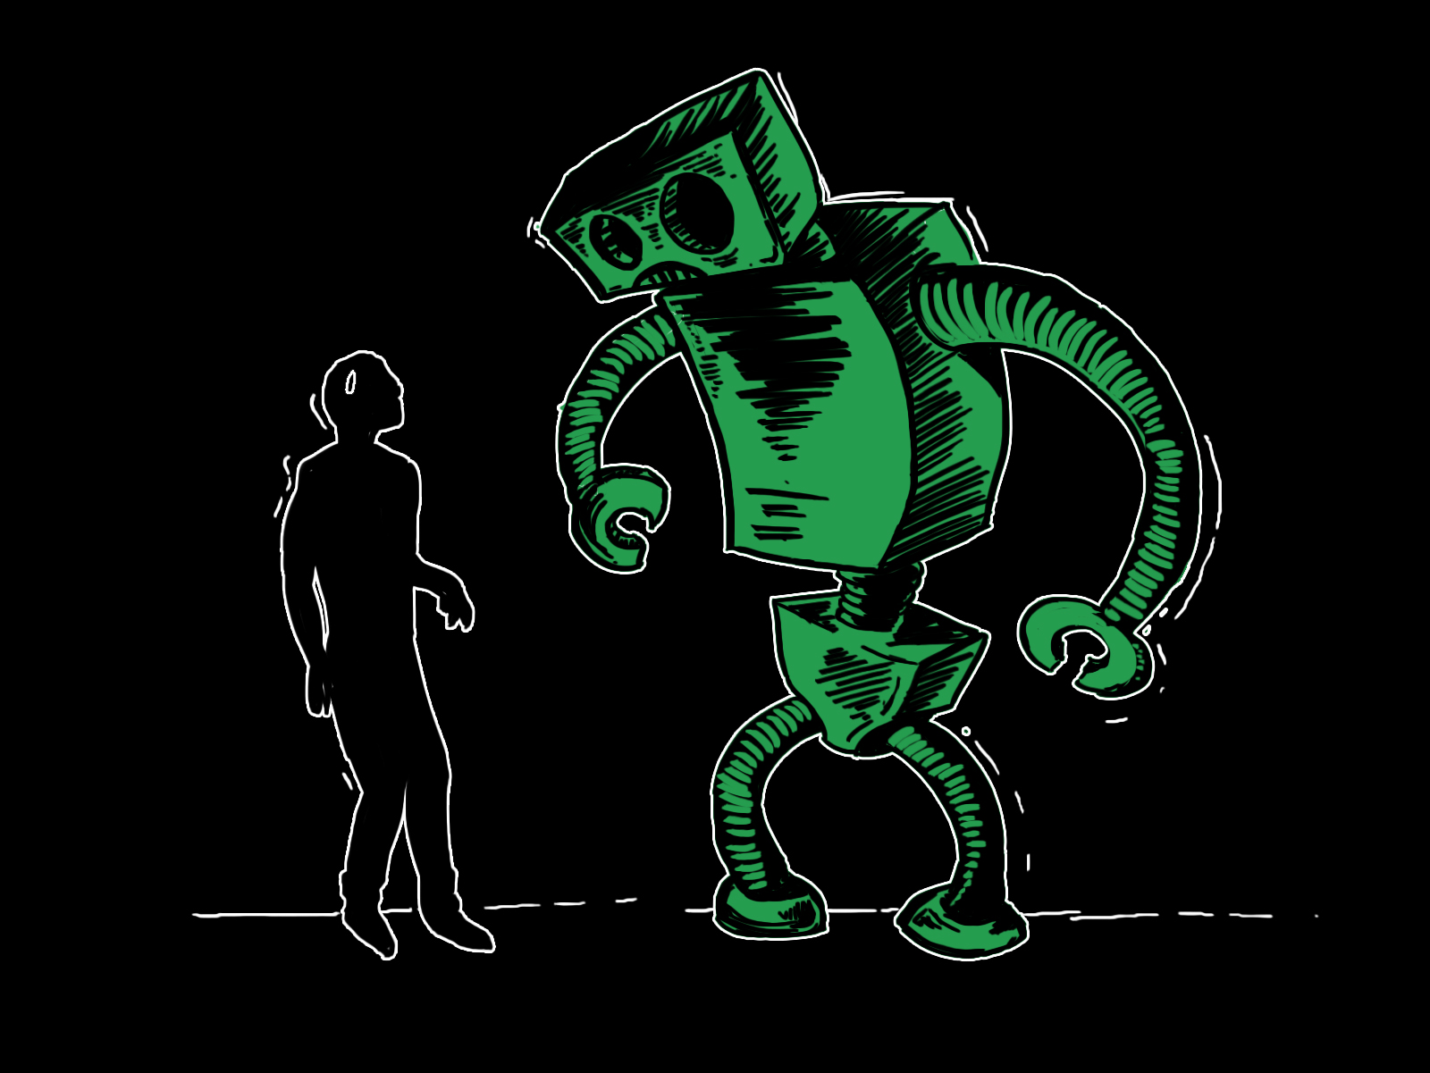
Notes:
Let's look at what used to inspire hackers and see if can find a new wave of inspiration. Early on it was man vs machine in the general sense. Phone systems built out of elaborate electro-mechanical moving parts that allowed communication over an incredible mesh of copper wire strung around the nation.
Image by Mar (sudux.com)

Slide 74
Notes:
It was the phreak who saw more than an old wall phone, they saw an entire world of unknown behind it.
x

Slide 75
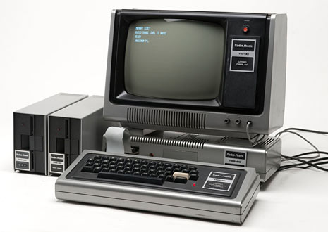
Notes:
Then it was the personal computer, especially early kits you assembled yourself. As the computer grew and became more powerful, more feature rich, it gave way to more modern networking. Bulletin board systems inspired us to communicate, to share.
x

Slide 76
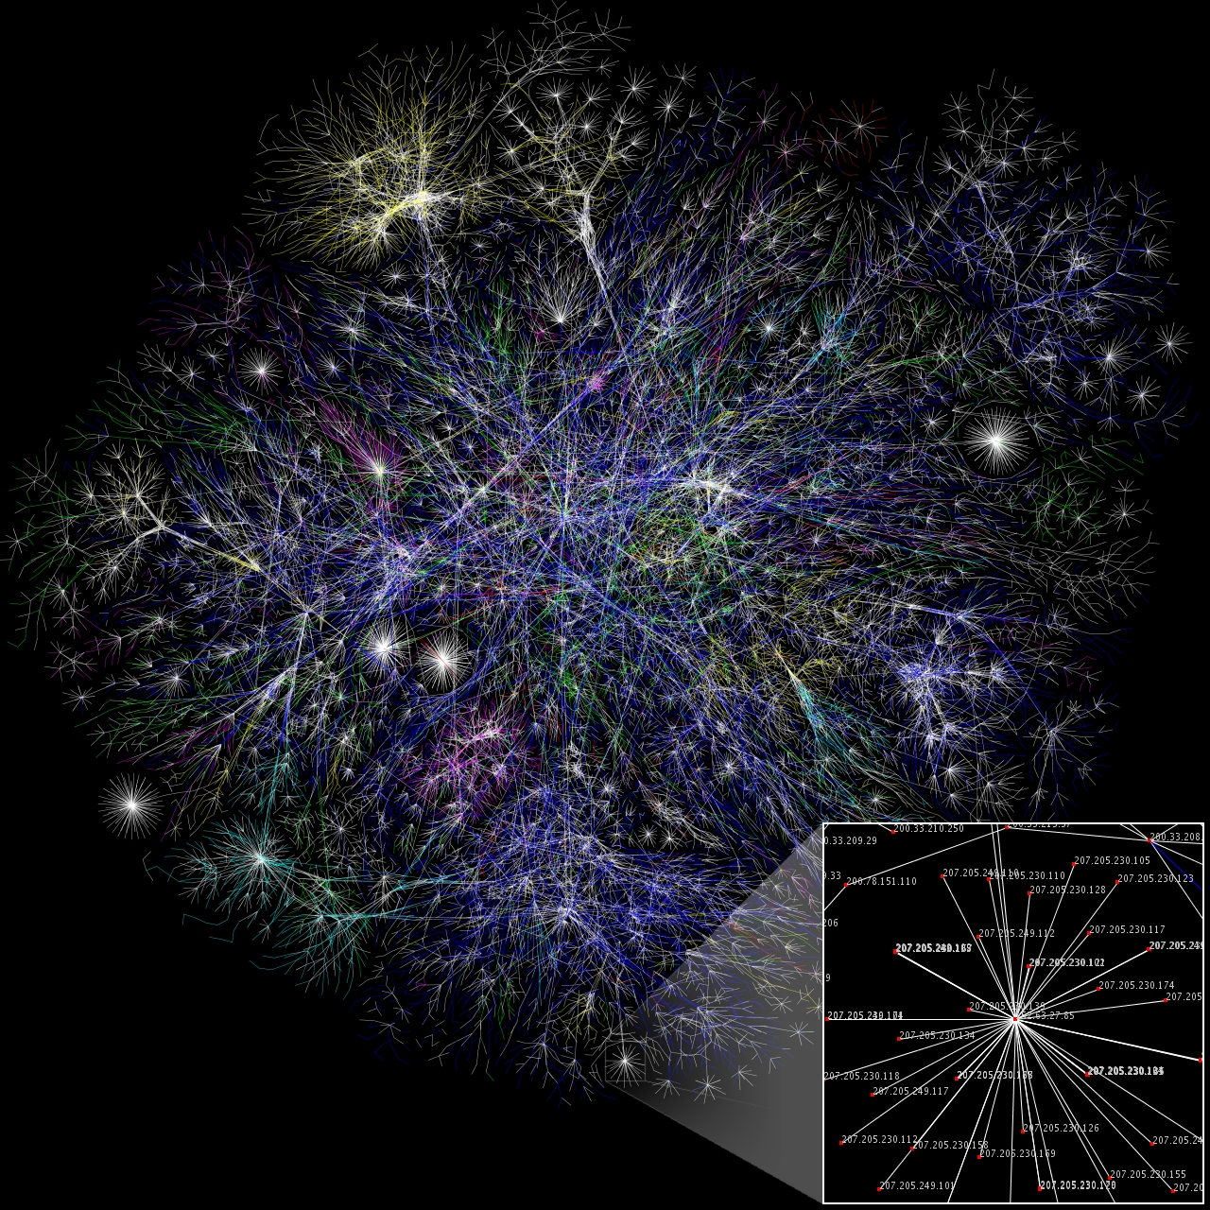
Notes:
The Internet made its appearance to many home users as the BBS world expanded. It quickly lowered the bar for entry to an online world, and was no longer relegated to graybeards, hackers, and researchers. That open network continued to inspire exploration as well as building tools to help explore. Sometimes those tools may have been a crowbar so-to-speak, but it was a different time and the rules were still being formed.
x

Slide 77
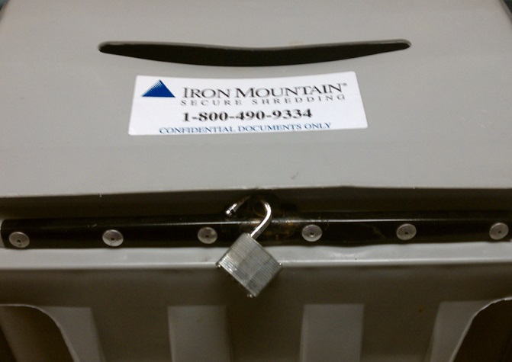
Notes:
Early hackers had it easy going up against systems with basically no security. When the first big roadblock appeared, namely the concept of security, it only deterred a few. The rest were further inspired.
x

Slide 78
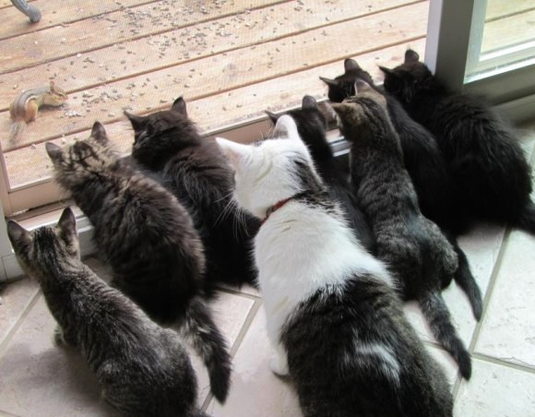
Notes:
Then admins started disabling services, changing default permissions, and putting up firewalls. At that point, a majority of avenues into systems were gone completely. The cat and mouse game intensified for a while.
Yes, that is a chipmunk not a mouse. Chipmunks are part of the Sciuridae family, so they are SQUIRRELS!

Slide 79
Notes:
And then the web happened. It brought back a lot of passion for finding new ways in for hackers losing interest in the network side.
x

Slide 80
Notes:
That roadblock of a firewall was no more, because it had to let traffic through to the web server. At first they were simple web servers and static content.
x

Slide 81
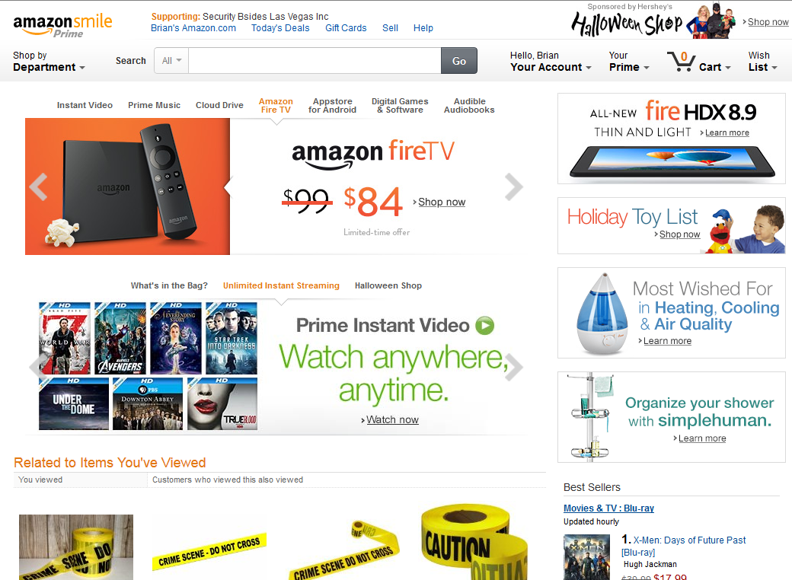
Notes:
Then, apps because robust, exposing not just a 'service' but a variety of them. Databases, PHP, JSON, XML, oh my. A dozen new classes of vulnerabilities popped up. XSS, SQLi, CSRF, traversal, authentication bypasses, and more.
x

Slide 82
Notes:
We learned that as security slowly catches up to attackers, inspiration can be harder to find. Even penetration testing can become a boring job sometimes. But it doesn't have to come from that constant cat/mouse game! there are many other ways to contribute meaningfully, and hopefully inspire others.
x

Slide 83
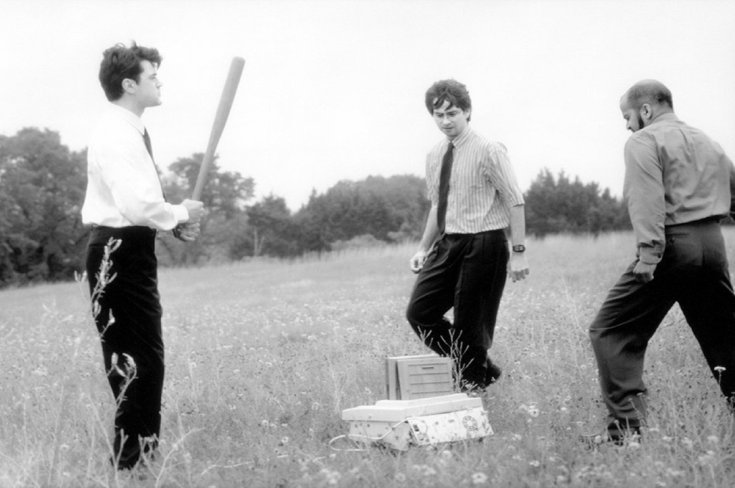
Notes:
We can all break shit. We all know that most software is not designed for security, that admins build systems for usability, and entire projects are graded by deadlines or budget.
x

Slide 84
Notes:
Hackers and security professionals like to boast about their greater intelligence as compared to many others. I largely agree with that, but i don't feel we have been showing it. We've proven for 50 years it is easier to break than build, so you aren't surprising anyone in security when you do it.
x

Slide 85
Notes:
So I challenge you!
x

Slide 86
Notes:
Give up the red cape and put on the blue t-shirt. Every part of daily life is working against the defenders already. Test your mettle and prove you are a badass at this InfoSec thing by switching sides and working on improving security technology, while keeping it usable for the average person. There are thousands of bad actors already in your networks, or desperately trying. The blue team is seriously outnumbered, out-gunned, and working with a tiny budget. To me, that sounds like a challenge and way to demonstrate you are a security professional.
x

Slide 87
Notes:
Find a new creative title you love, have fun with it, embrace it, and run with it if that empowers you… as long as it isn't "evangelist”.
x

Slide 88
Notes:
Hopefully you found some meaning or inspiration in this talk. If not, I’ll be here taking money for seat reservation for the next talk.
Image source: https://twitter.com/kickfroggy/status/516332373953507328 / http://twitpic.com/ec7090 (DerbyCon 2014)

Slide 89
Questions?

