Slide 1
How did we get here, knowing what we know?
Notes:
Abstract.. check. Bio... check. Title for this talk... fuck. Image: Photos by Ed Skoudis, graphics enhancements by Mar, off white text me!
Computer security is in bad shape. No, that is putting it nicely. Our state of security is entirely dismal. Apologists will sometimes dismiss this as our industry being 'young'. Sure, compared to building pyramids or fire, it is. But compared to the modern car industry, circa Ford and their Model T in 1908? Our industry is arguably just as old. And to go with that age, vulnerabilities from back then are still plaguing us to this day. How did we get here, knowing what we know?
This talk will give a brief but amusing overview of the history of vulnerabilities. With each crazy story we will see that the lessons buried in our history are just as important now as they were then. Yet, miraculously, we've somehow ignored that... This talk is not about painting a complete history, as that would take several books. This is about perspective.
So first, a few quick rules…

Slide 2
Notes:
Have questions? Wait until the end.
If I am wrong about something? Interrupt me.
(If you are right, I will make amends. If you are wrong, you will be mocked.)
Those familiar with my past talks will notice a change in style this time…
Image source:
http://i1.kym-cdn.com/photos/images/original/000/328/179/652.jpg

Slide 3
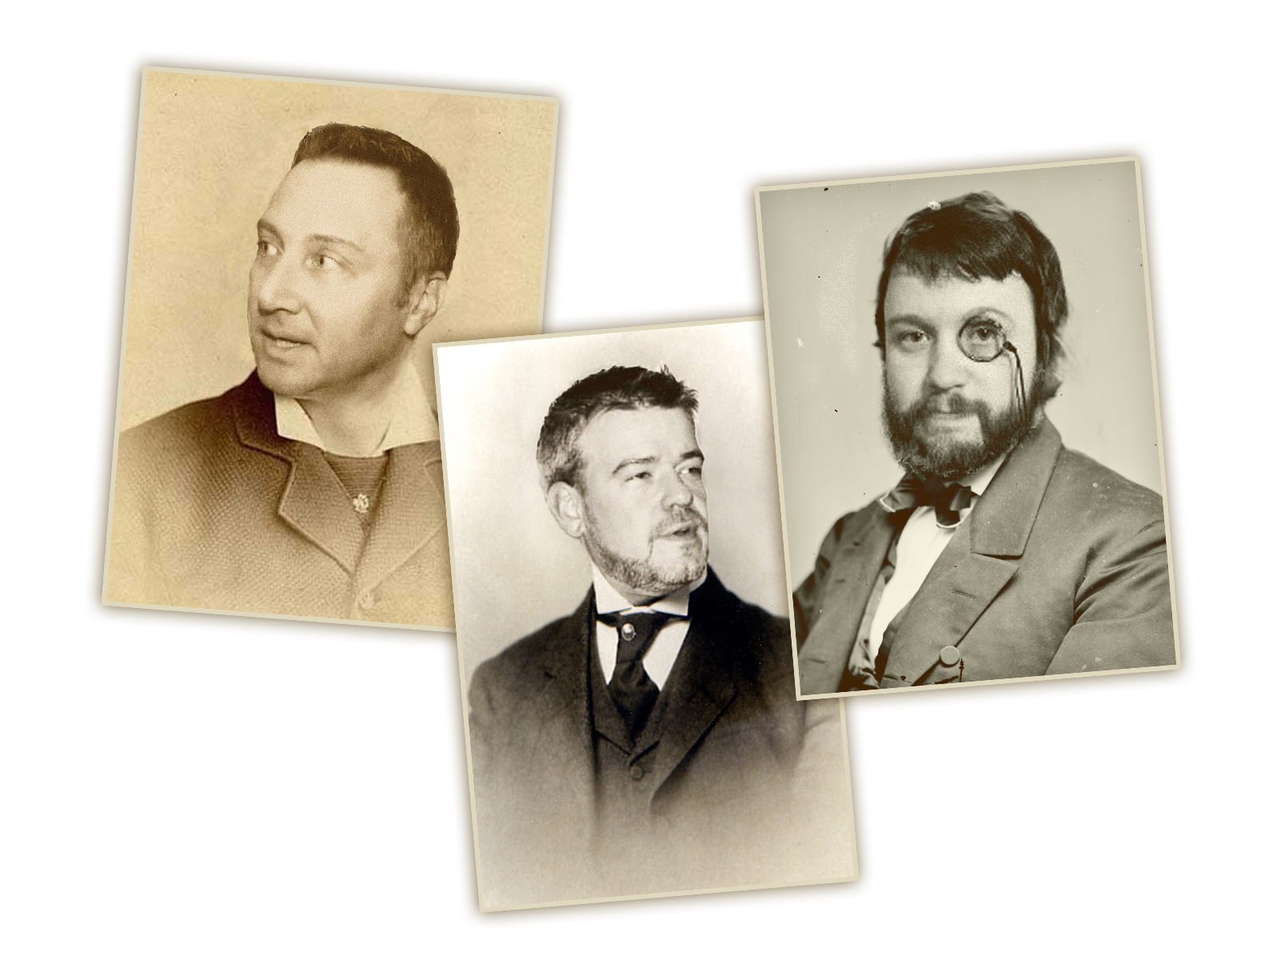
Notes:
.. That change is due to influence from watching talks of Schuyler Towne, Chris Nickerson, and Alex Hutton. With this change…
Image source: Mar (mar@sudux.com)

Slide 4
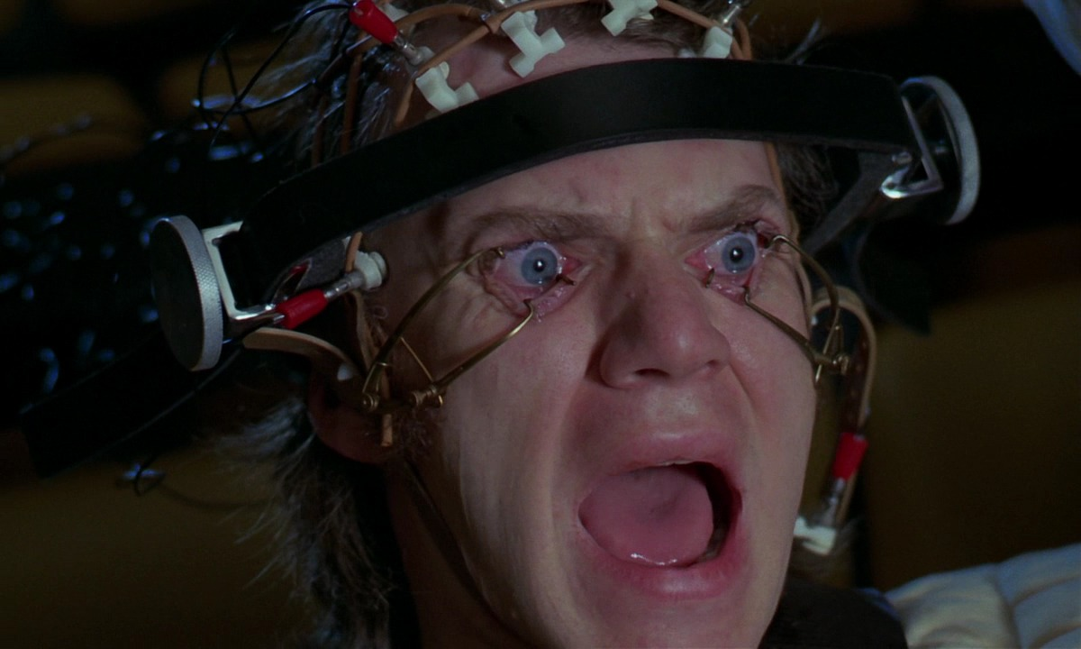
Notes:
… you are my guinea pigs so to speak. If I can’t adapt to this style of talk…
Image from: A Clockwork Orange (http://www.imdb.com/title/tt0066921/)

Slide 5
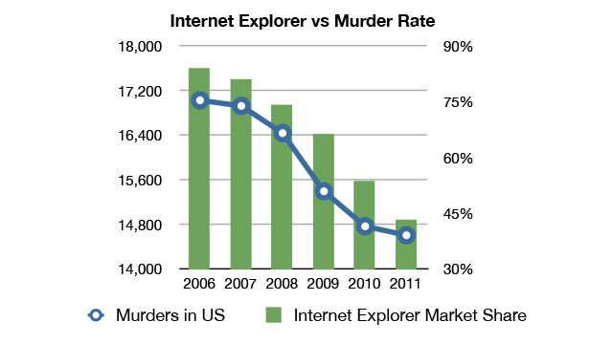
Why Vulnerability Stats Suck
Stats are presented without understanding the limits of the data
Even if explanations are provided, correlation is confused with causation:
Notes:
Then I’ll go back to the old style.
And now a quick word of warning…
http://gizmodo.com/5977989/internet-explorer-vs-murder-rate-will-be-your-favorite-chart-today
https://twitter.com/altonncf/status/293392615225823232

Slide 6
Notes:
I think we’re all familiar with Trigger words. Consider my entire persona and being a trigger warning. You have been warned!
On the top of persona, who am I?

Slide 7
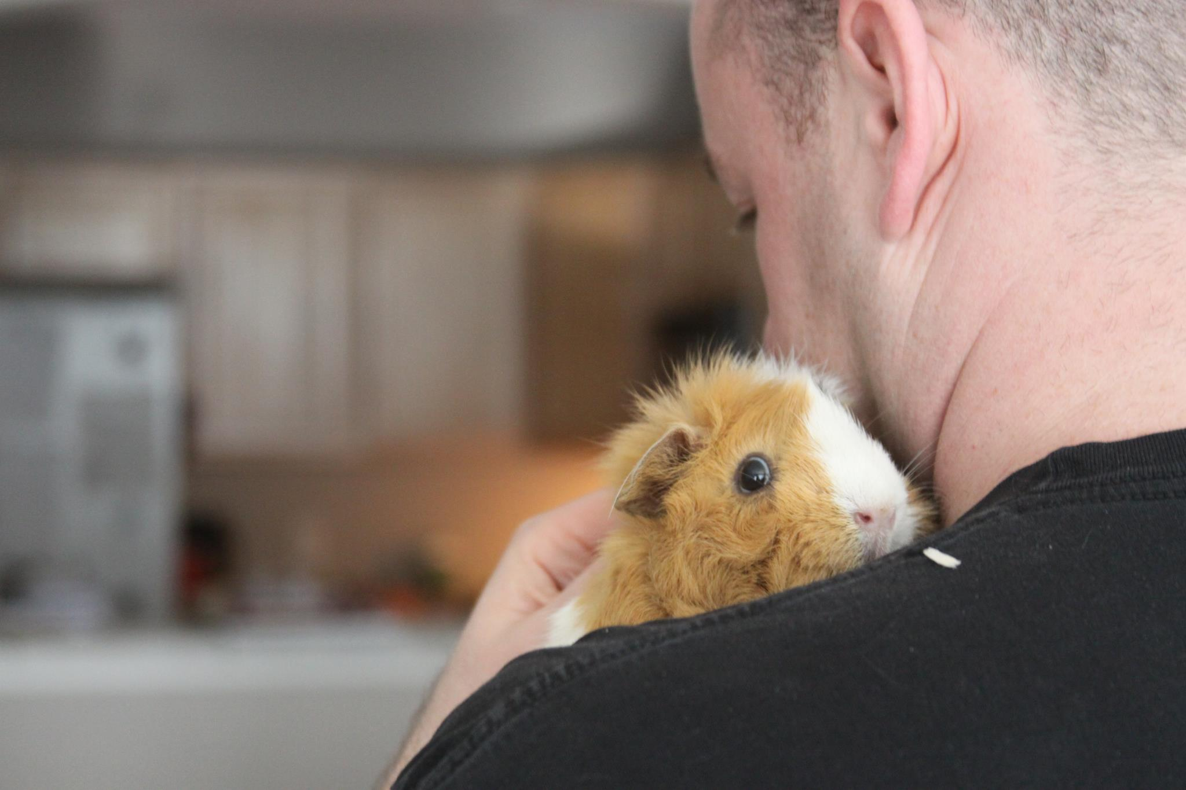
Notes:
Just some guy who likes small misunderstood creatures. That’s zesty.
Ok, the part that matters?

Slide 8
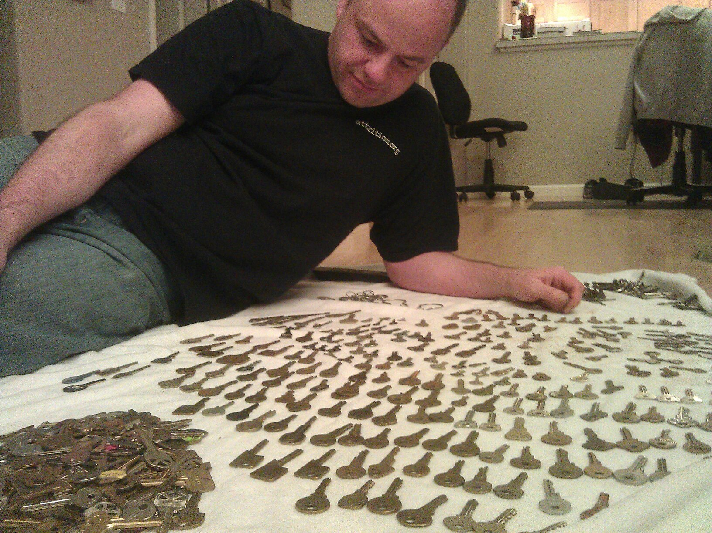
Notes:
I collect things. Always have. This matters because…

Slide 9
Collect all the Vulns
98,012 vulnerabilities
65,878 products
9,183 vendors
6,459 researchers
111 years
… spanning
… from
… disclosed by
… over
@OSVDB
Notes:
… I collect vulnerabilities just like anyone else collects stamps, coins, or STDs.
No that is not a tequila-induced typo. 111 years (we shifted into a new year since I started this talk!). We’ll get there.
What went into preparing for this talk?
More info: http://opensecurityfoundation.org/
More info: http://osvdb.org/

Slide 10
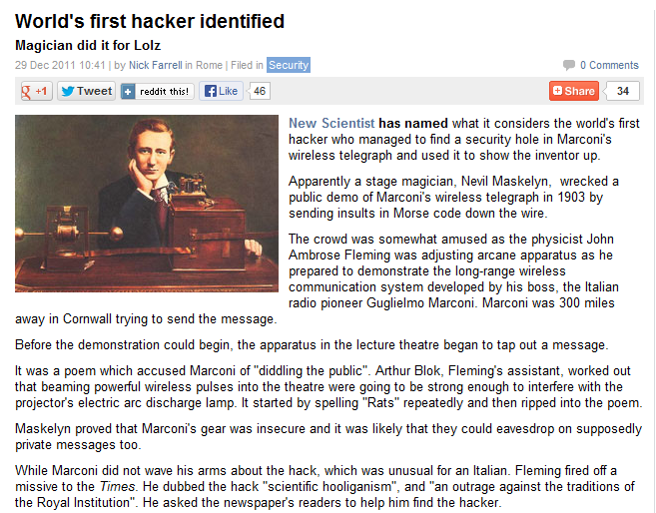
Notes:
Well, I read some articles…
e.g. http://news.techeye.net/security/worlds-first-hacker-identified

Slide 11
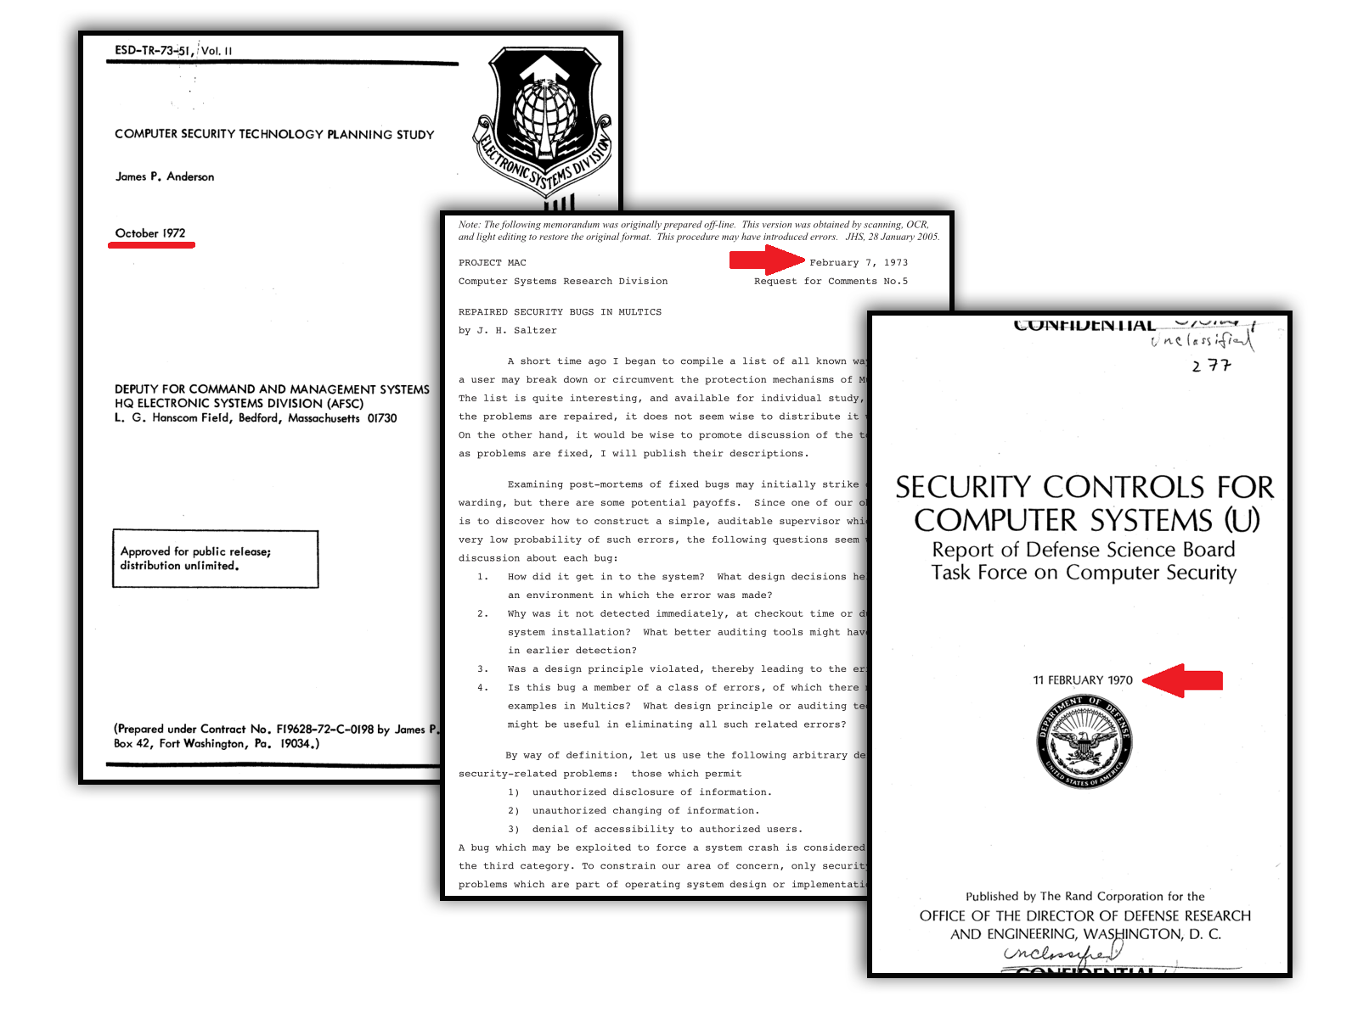
Notes:
I read some fun research papers…
Pictured:
“Computer Security Technology Planning Study” by James P. Anderson, October 1972
Per author request: “should not be referenced in other publications”, February 1973
“Security Controls for Computer Systems (U)” by Report of Defense Science Board Task Force on Computer Security, February 1970

Slide 12
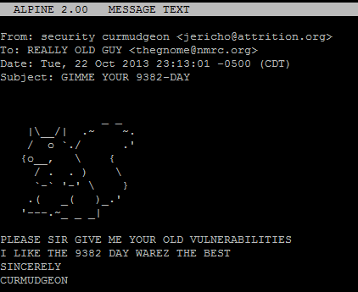
Notes:
I emailed a lot of people older, smarter, and wiser than I…
A few examples:
Simple Nomad, Jerry Saltzer, David A. Curry, Tom Van Vleck, Bill Ricker, and many many more. Sincere thanks for them indulging me on my quest for ancient vulnerabilities.

Slide 13
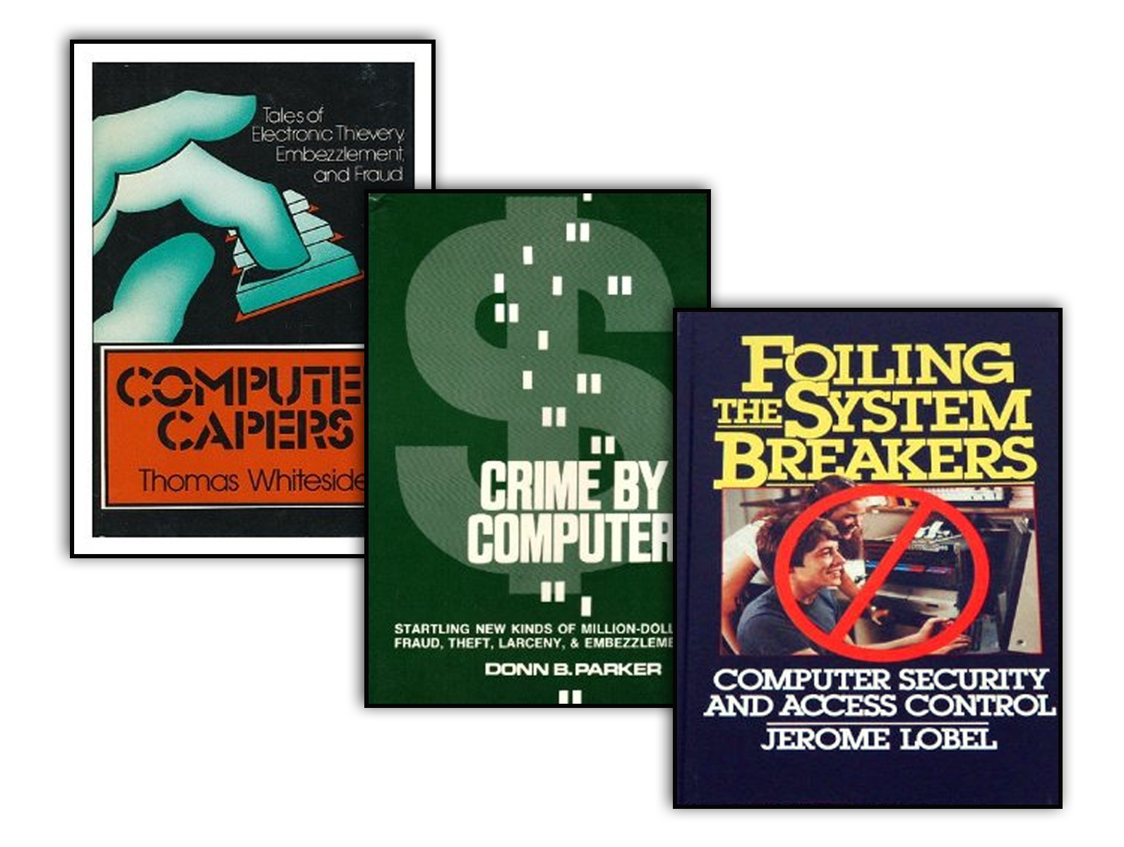
Circa 1973
Notes:
I read some books for perspective… and what did this lead me to to? This talk.
So an overview… On the surface this will seem like a sad and depressing talk…
Pictured:
http://www.amazon.com/exec/obidos/ISBN=069001743X/insekurityorgA/
http://www.amazon.com/exec/obidos/ISBN=0684155761/insekurityorgA/
http://www.amazon.com/exec/obidos/ISBN=007038357X/insekurityorgA/

Slide 14
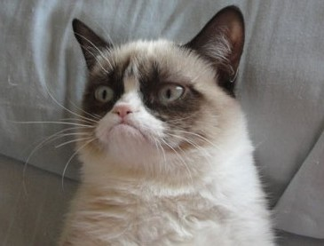
Notes:
In reality it should hopefully motivate and encourage you to do better, by doing what you already do, just differently.
Image source: http://dashburst.com/10-cats-grumpier-than-grumpy-cat/

Slide 15
Notes:
If we can fix things, everyone is happy.
Let’s face it, we all know how bad things are…
Image source: http://www.catster.com/molz/happy-cat-is-happy

Slide 16
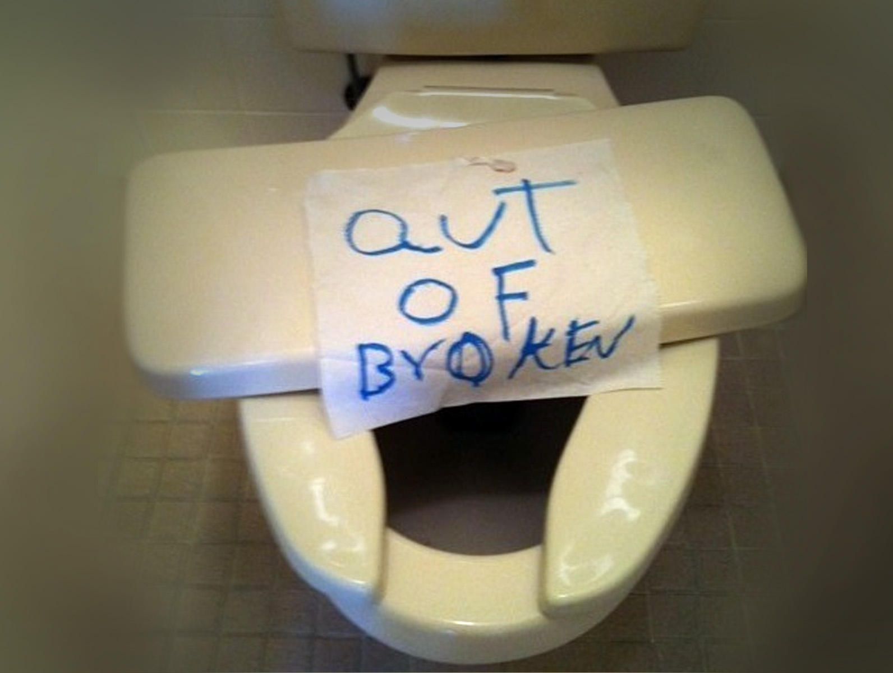
Notes:
But this talk will hopefully give you MORE historical perspective to fully understand and appreciate where we really are.
There is a common saying regarding history…
Image source: http://cheezburger.com/6132125696

Slide 17
“Those who cannot remember the past are condemned to repeat it.” -- George Santayana
Notes:
Those who cannot remember the past are condemned to repeat it. Of course, this spawned a hundred variations that we now also attribute to Shepard, Burke, Vonnegut, and the esteemed Jesse Ventura, but who’s counting!
Ok enough intro, let’s get to the meat of this presentation. When talking about vulnerability history, you really have to pick a start date and that may be a bit arbitrary.
http://en.wikiquote.org/wiki/George_Santayana
http://www.goodreads.com/quotes/tag/doomed-to-repeat-it

Slide 18
Pre-history
(but relevant)
1960’s
1950’s
1930’s
1900’s
Notes:
Ten years ago I would have picked the 1960’s. Five years ago the 1950’s or arguably the 1930’s. Now, I think the 1900’s is a good start point.

Slide 19
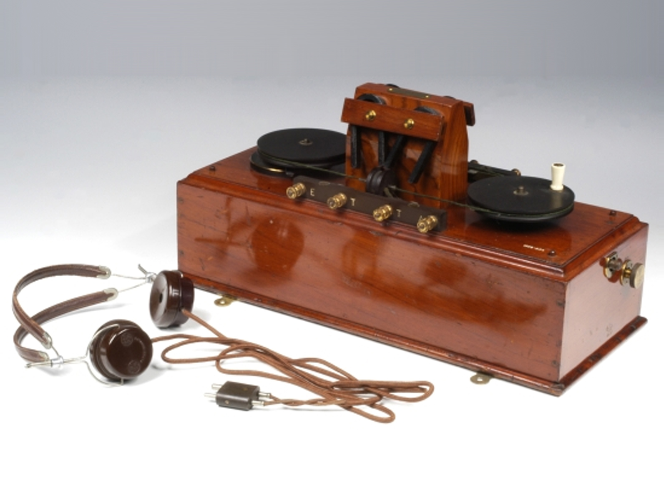
Notes:
We’ll start with the story of the Marconi Wireless Telegraph, courtesy of New Scientist and TechEye.net
Invented in the years leading up to 1903, this was a significant advance in communication technology.
Picture courtesy of http://www.mhs.ox.ac.uk/marconi/exhibition/7777.htm
Full stories:
http://news.techeye.net/security/worlds-first-hacker-identified
http://www.newscientist.com/article/mg21228440.700-dotdashdiss-the-gentleman-hackers-1903-lulz.html#.UlWR6UAy6SC

Slide 20
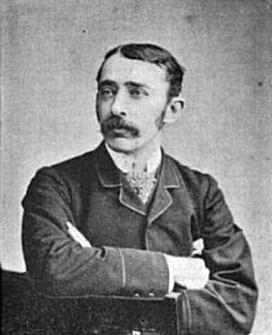
?
Notes:
The primary creator was the Italian Guglielmo Marconi who had assistants John Ambrose Fleming and Arthur Blok. Poor Arthur was not important enough to warrant a Wikipedia page, so no picture of him.
Maroni, like most security vendors today, said his device was SECURE and that messages were PRIVATE.
"I can tune my instruments so that no other instrument that is not similarly tuned can tap my messages," Marconi boasted.
http://en.wikipedia.org/wiki/Guglielmo_Marconi
http://en.wikipedia.org/wiki/John_Ambrose_Fleming

Slide 21
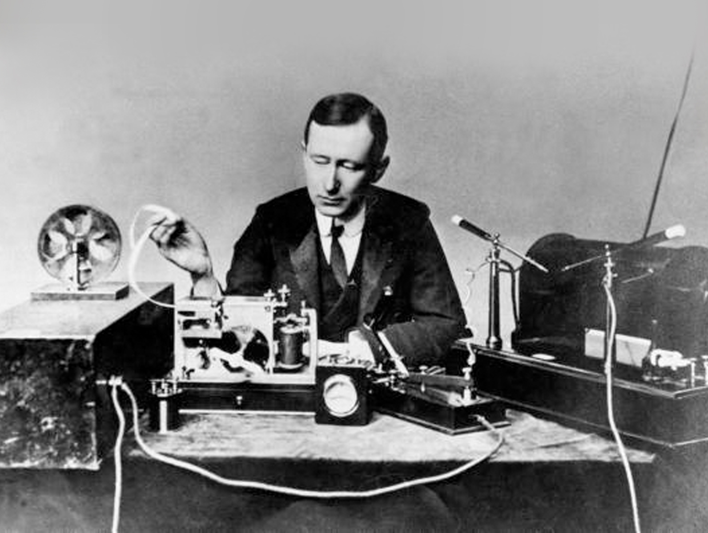
Notes:
To show off his new device, Marconi set up a public demonstration in a theatre. He was in Cornwall, 300 miles away from the crowd ready to send the message.
Fleming was set up to receive the message and impress the crowd.
Minutes before the wirelessly transmitted message was to arrive, the crowd heard a ticking noise from the theatre’s brass projection lantern.
Poor assistant Blok recognized it to be morse code, not the brilliant physicist Fleming with a Wikipedia page.
Blok figured someone was sending powerful wireless pulses that were strong enough to interfere with the projector’s discharge lamp.
Mentally decoding the missive, Blok realized it was spelling one facetious word…
Image source: http://en.wikipedia.org/wiki/Guglielmo_Marconi

Slide 22
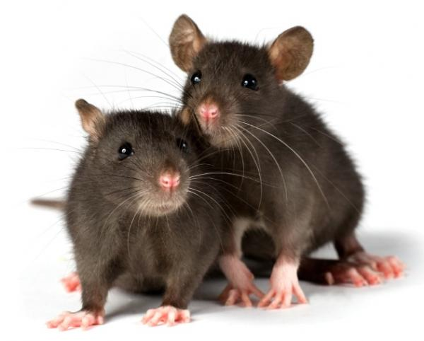
Notes:
"Rats“ … over and over.
Marconi wasn’t happy about this, but like some security vendors today, he wouldn't address critics.
"I will not demonstrate to any man who throws doubt upon the system," he said at the time.
Image source: http://scientopia.org/blogs/scicurious/2012/01/04/sad-lonely-lady-rats-may-really-eat-their-feelings/

Slide 23
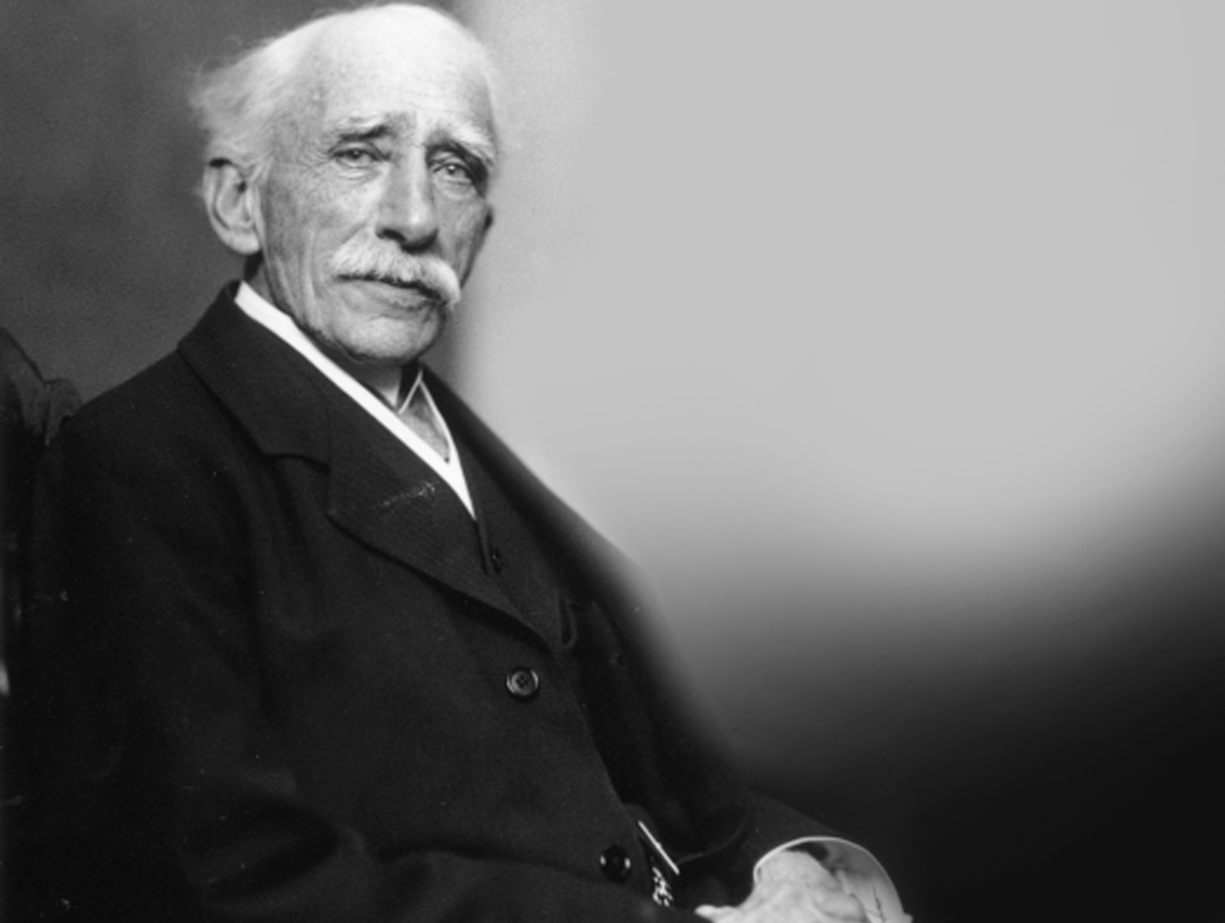
Notes:
His main man Fleming, pictured here later in life, wasn’t so rigid.
He sent a fuming letter to The Times of London dubbing the hack "scientific hooliganism” (wow what an awesome term), and "an outrage against the traditions of the Royal Institution".
Much like vendors today screaming “that isn’t a vulnerability, it’s a design feature!”
Like someone getting trolled, he asked the newspaper for help identifying the culprit.
A mere four days later, a gleeful letter confessing to the hack was printed by The Times.
Image source: http://www.biography.com/people/john-ambrose-fleming-9296963

Slide 24
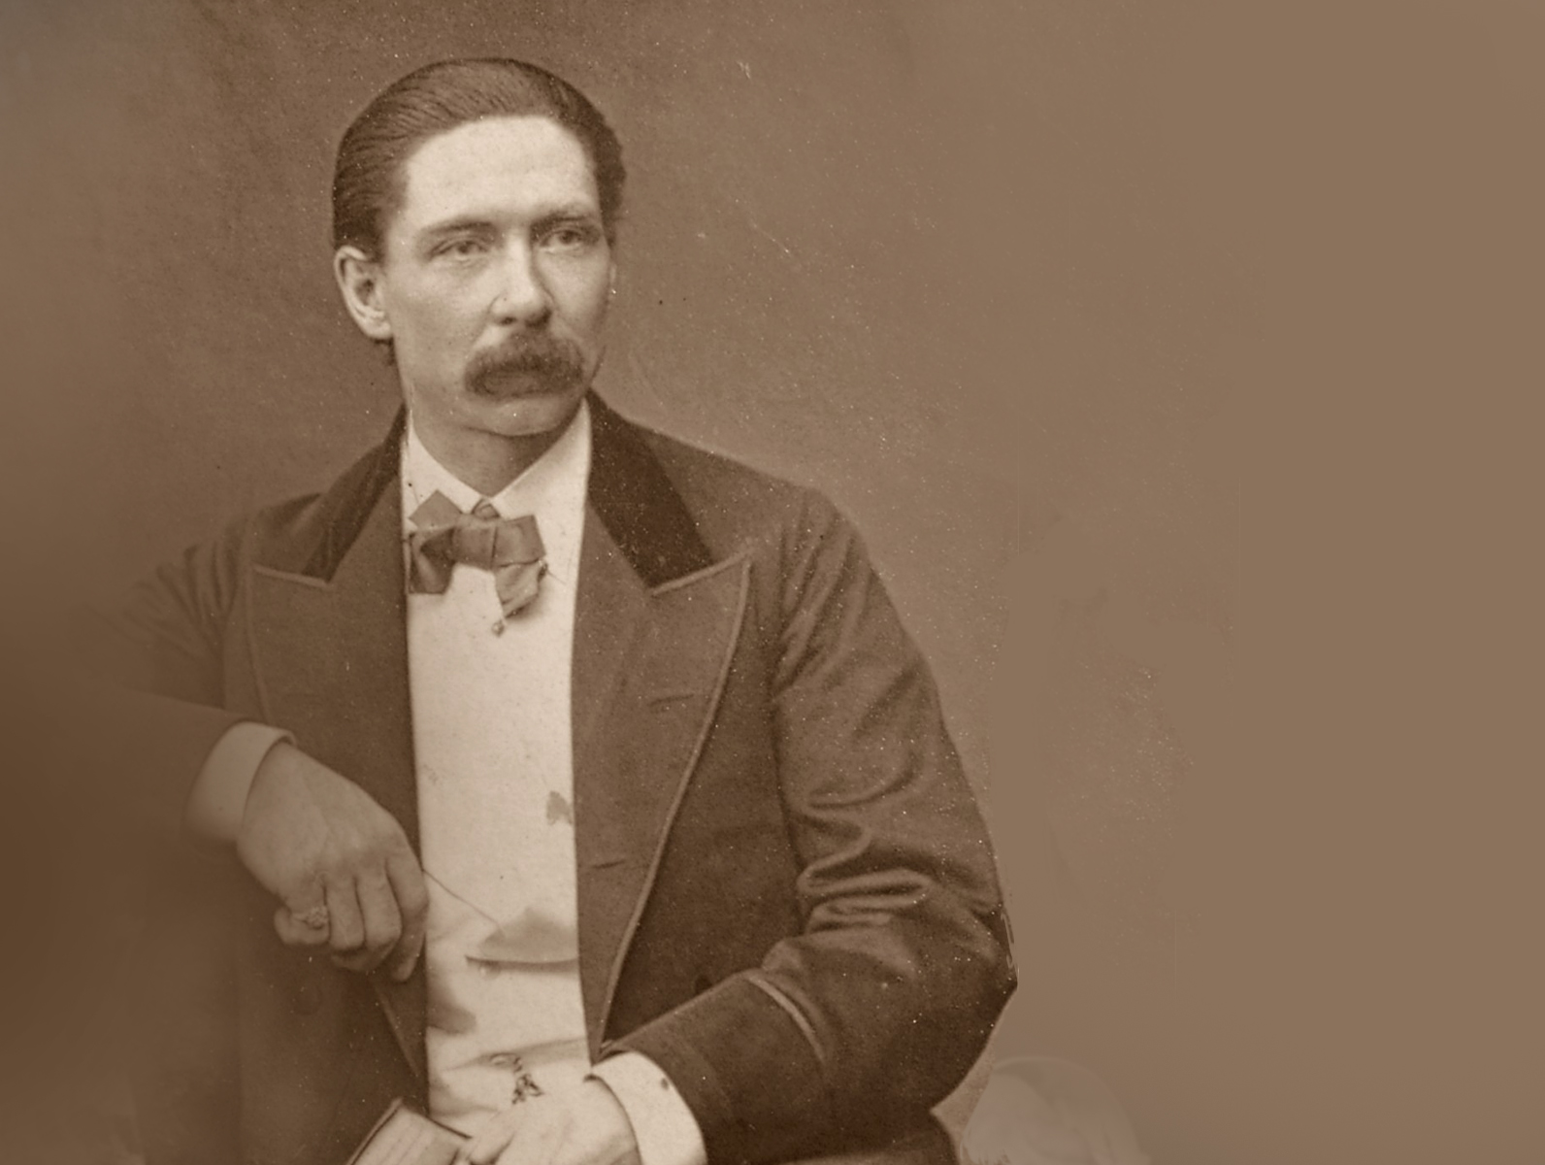
Notes:
This fine mustachioed gentleman is John Nevil Maskelyne, a stage magician and inventor, who decided troll Marconi and show him that his notions of PRIVATE were a joke, and admitted to it.
Basically, you arguably have the world’s first ‘modern’ hacker, and like today’s, he was flexing his e-peen.
So Marconi’s patented technology for broadcasting on a “precise wavelength” was shattered.
Of course today, we know this to be simple technology. Tune the radio to a different channel…
Image source: http://en.wikipedia.org/wiki/John_Nevil_Maskelyne
1902-11-07 Marconi Wireless Telegraph Transmitted Message Remote Disclosure http://osvdb.org/79399
1902-11-07 Marconi Wireless Telegraph Crafted Transmission Message Spoofing http://osvdb.org/79400

Slide 25
Notes:
The story goes deeper…
Maskelyne was apparently hired by the Eastern Telegraph Company to undertake spying operations on Marconi over a year before this incident.
Maskelyne had even written an article in the Nov 7, 1902 issue of ‘The Electrician’ about the technology, at least half a year before the demo.
The comparisons to full disclosure, wiley hackers, and Internet trolls is strong in this story. Personally, I am waiting on the movie given all the intrigue and drama.
LESSON: If you say it is secure or private, verify first.
Image from Journal: http://books.google.com/books?id=jhdbAAAAYAAJ&lpg=PA501&ots=w5BK43mVA0&dq=The%20Electrician%201902%20magazine&pg=PA95#v=onepage&q=The%20Electrician%201902%20magazine&f=false
OSVDB:
http://osvdb.org/79399
http://osvdb.org/79400
(As a result of researching this talk, the disclosure date for those vulns was updated from 1903-06-01 to 1902-11-07.)

Slide 26
Notes:
Next we jump to the 1930’s and 1940’s, largely centered around World War 2.
Several countries developed or used electro-mechanical rotor cipher machines for message security.
The most famous was the Enigma, invented by a German engineer named Arthur Scherbius.
Early models were used commercially from the early 1920s and later models used into the 1940s.

Slide 27
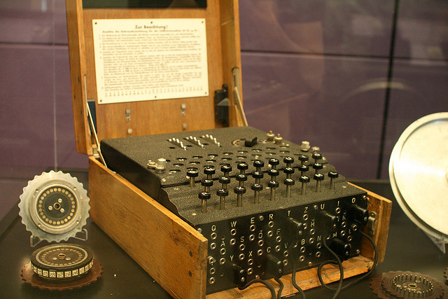
Notes:
Enigma
1932 - first break of German Army Enigma by Marian Rejewski in Poland
Over the coming years subsequent models would be broken by other countries.
Image source: http://www.flickr.com/photos/francois/1162284306/ by François Proulx
1939-07-25 Enigma Machine Limited Persistent Indicator Chosen Message Key Encryption Weakness http://osvdb.org/92994

Slide 28
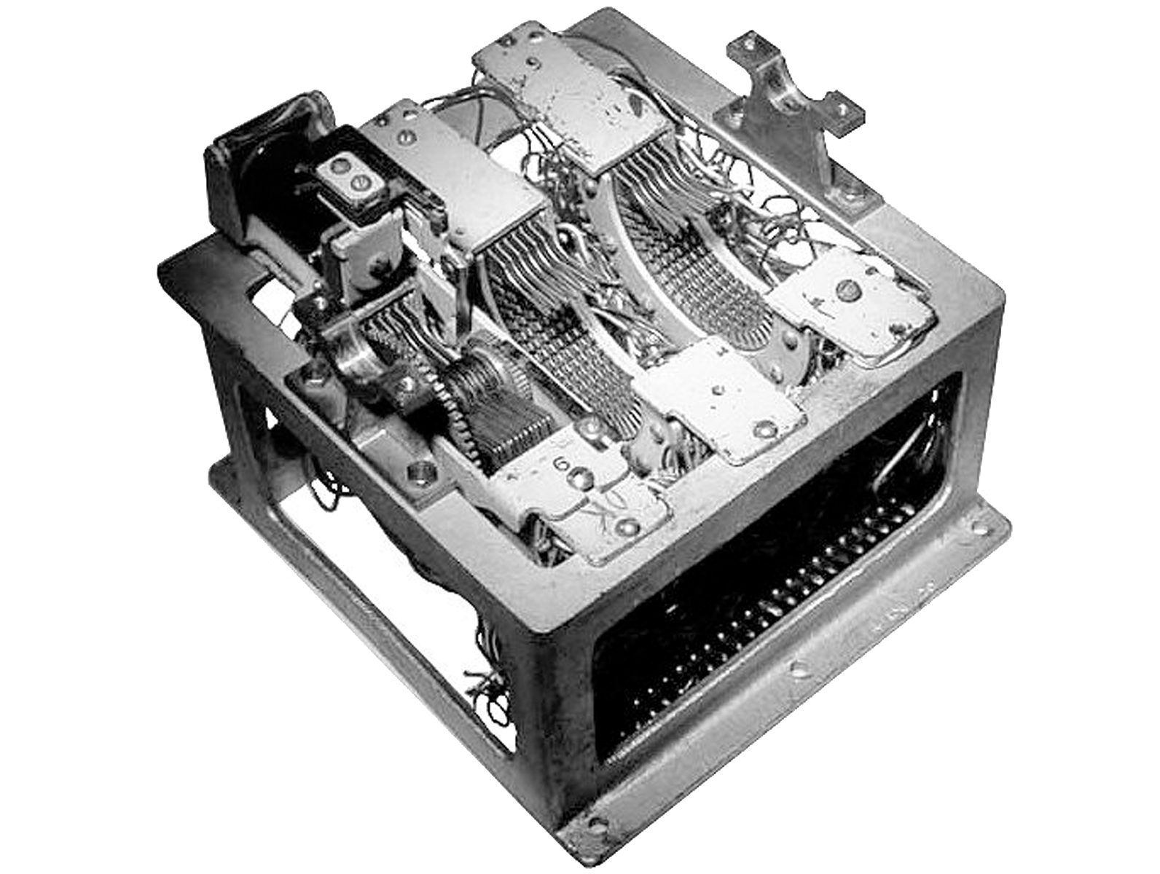
Notes:
Japan: 97-shiki O-bun In-ji-ki, which means Alphabetical Typewriter 97, or just “Purple” and intercepts “Magic”. Diplomatic, not military.
1940 - Break of Japan's PURPLE machine cipher by SIS team
http://en.wikipedia.org/wiki/Purple_(cipher_machine)
Image source: http://www.jproc.ca/crypto/purple.html

Slide 29
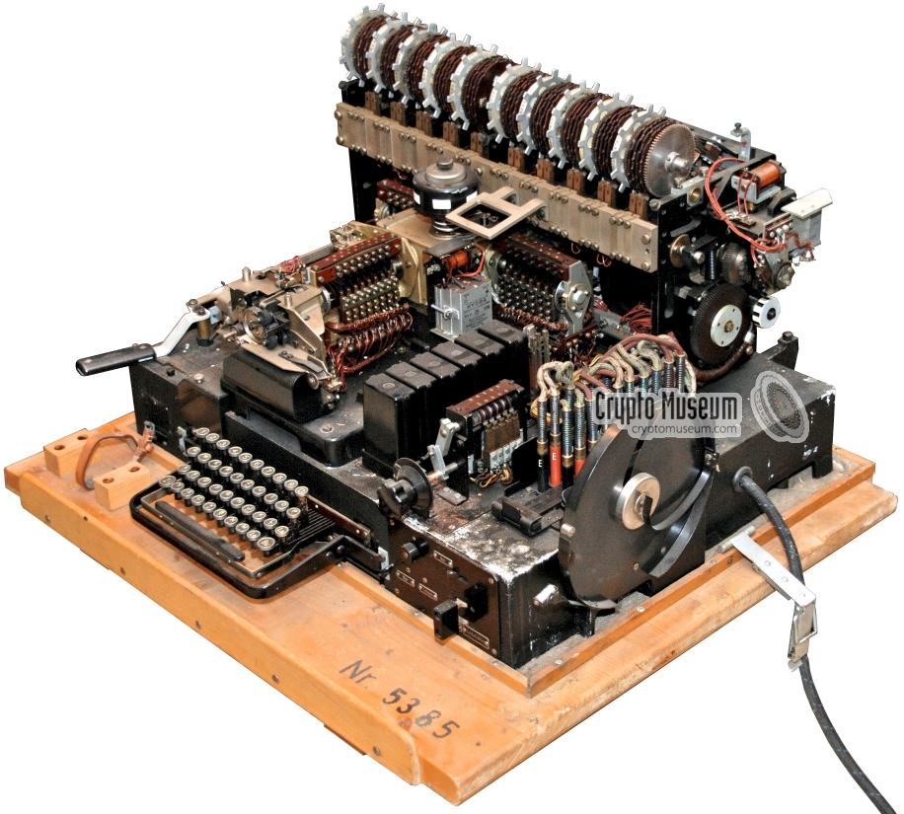
Notes:
Siemens T-52 Geheimschreiber code named “STURGEON”. May 1940, cracked by the Swedes who could tap the hard lines.
http://en.wikipedia.org/wiki/STURGEON_%28cryptography%29
http://www.cryptomuseum.com/crypto/siemens/t52/img/t52d_large.jpg

Slide 30
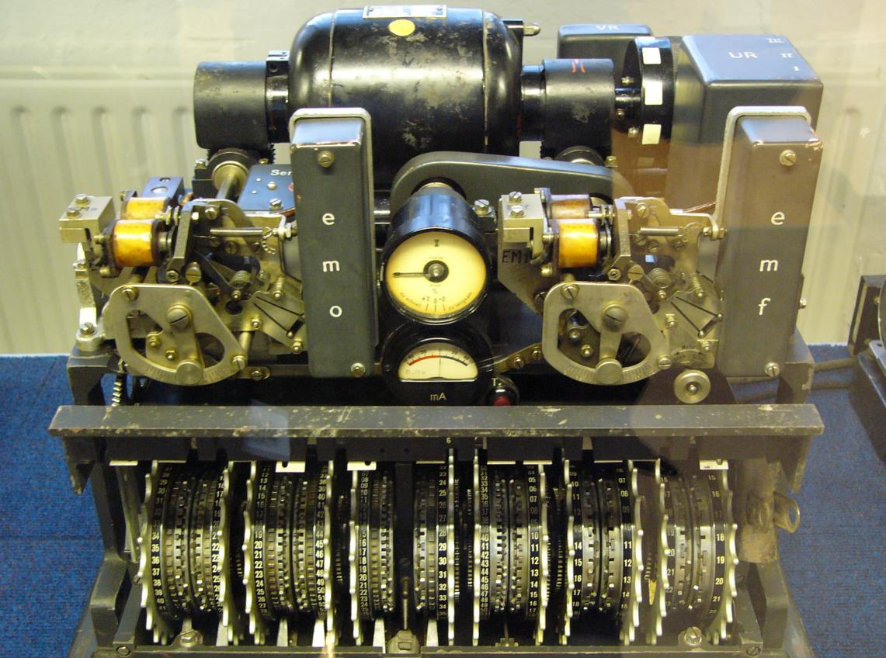
Notes:
Lorenz SZ40, SZ42A and SZ42B. Lorenz was initially cracked in 1942. Aka “TUNNY”
Know it our not, we can thank this little beauty for leading to what came after:
December 1943 - The Colossus computer was built, by Thomas Flowers at The Post Office Research Laboratories in London, to crack the German Lorenz cipher (SZ42).
The Lorenz machine was improved twice (SZ-42a and SZ-42b) and was broken during WWII by the codebreakers at Bletchley Park (UK) with the aid of Colossus…
http://en.wikipedia.org/wiki/Lorenz_cipher
http://upload.wikimedia.org/wikipedia/commons/4/4d/Lorenz-SZ42-2.jpg

Slide 31
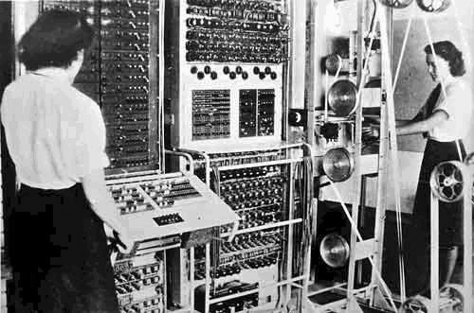
Notes:
One fun takeaway was breaking the Lorenz was done with the first electronic DIGITAL computer, named Colossus in 1943. http://en.wikipedia.org/wiki/Colossus_computer
This predates the Eniac, the first was the first electronic GENERAL-PURPOSE computer in 1946. http://en.wikipedia.org/wiki/Eniac
The other fun takeaway? Women were working on computers as long as men. #feminism what?
Fun Colossus image: http://img.dailymail.co.uk/i/pix/2007/11_02/033COLOSSUS_800x491.jpg 9ft High, 16ft Long, 10ft Wide. 5500 watts power. Equiv to modern PC.

Slide 32
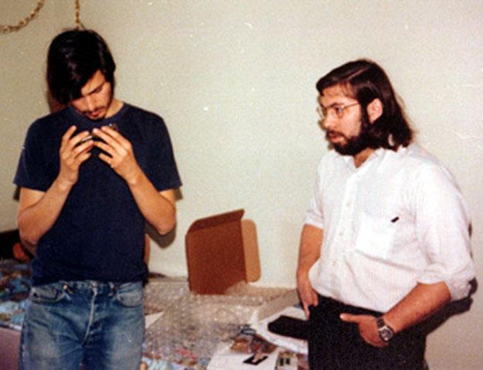
Notes:
Everyone recognizes these two criminals that built an empire on the back of crime right? Steve Jobs and Steve Wozniak.
While they came later, this brings us to 1950s - Rise of the Phone Phreaks
Many forget these were electro-mechanical machines that turned into huge digital computers.

Slide 33
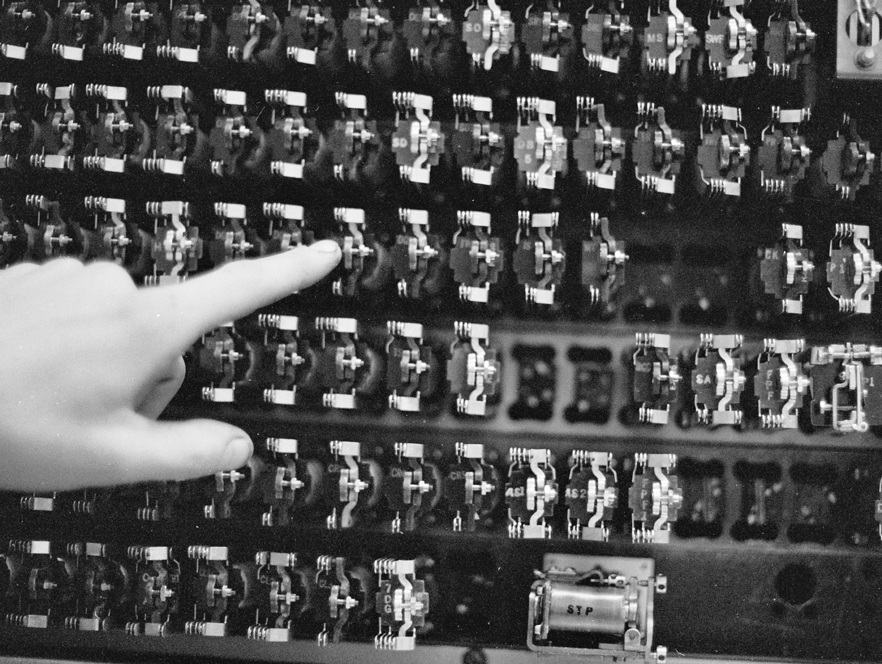
Notes:
1955-01-01 Western Electric Labs Panel Machine Switching System (MSS) Ring Forward Signal Spoofing Weakness
Predates the classic blue boxing. User-supplied input (1000Hz modulated signal) to seize an internal trunk between cities. Then ask the remote operator to connect to a local number.
Image source: http://en.wikipedia.org/wiki/Panel_switch
Vuln ref: http://osvdb.org/97295

Slide 34
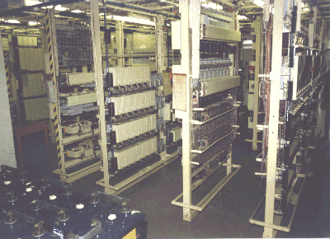
Notes:
1956-07-01 Western Electric Labs Crossbar Switch Off Hook Race Condition Billing System Bypass
1956-07-01 General Telephone Strowger Step by Step Switch Off Hook Race Condition Billing System Bypass
Crossbar and Strowger Step-by-Step. Exploit at the time was known as the “black box”. Via a race condition of the phone going on/off hook fast, could make a call without the billing system kicking in.
Image source: http://en.wikipedia.org/wiki/Strowger_switch
Vuln info: http://osvdb.org/97334
Vuln info: http://osvdb.org/97335

Slide 35
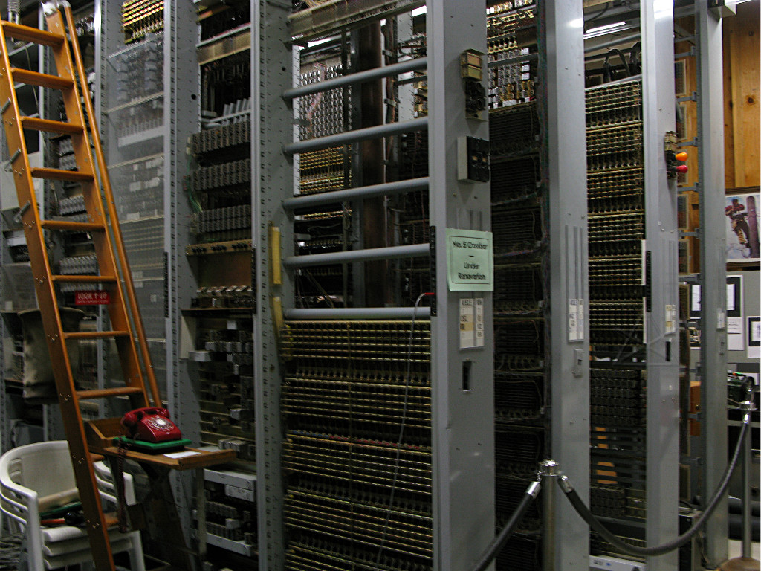
Notes:
1960-12-01 Western Electric Labs #4A Crossbar Tone Spoofing Control Channel Hijacking Weakness
Infamous Blue Box. carefully timed 2600Hz tone (or seventh octave E) down the line could trick the remote switch into thinking the trunk is idle. Free call!
Image source: http://techno-fandom.org/~hobbit/pix/rt11a/ from The Telephone Museum in Ellsworth, Maine a 501(c)(3)
Vuln info: http://osvdb.org/97296

Slide 36
Notes:
This is where the phone company learned the hard way that user input was a bitch.
Toys and electronics could both be used to circumvent the system to make free calls.
Blue Box (upper left / lower right) from http://www.offcon.org/phone-phreaking-demonstration.html and http://calitreview.com/37426/blind-boys-berkeley-blue-phone-hacks-and-wozniak/
Davy Crockett Cat and Canary Bird Call Flute ( ) from http://www.slate.com/blogs/the_vault/2013/02/01/phone_phreaks_the_toy_whistles_early_hackers_used_to_break_into_the_phone.html
Capn Crunch Bo’sun Whistle ( ) from http://www.slate.com/blogs/the_vault/2013/02/01/phone_phreaks_the_toy_whistles_early_hackers_used_to_break_into_the_phone.html

Slide 37
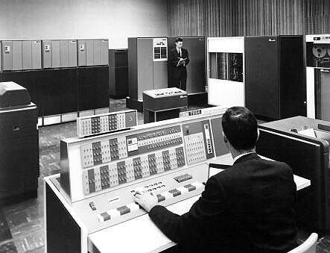
Notes:
OK now the “computer” history we’re more familiar with.
We know the Colossus and Eniac predated, but the 1960s brought us real multi-user machines.
No grand story for this decade, a handful of computer vulns and nothing dramatic =(
Image source: http://securitywatch.pcmag.com/vulnerabilities/284632-the-world-s-oldest-software-vulnerability (story based on my contest to find the oldest vuln, which is no longer the oldest!)

Slide 38
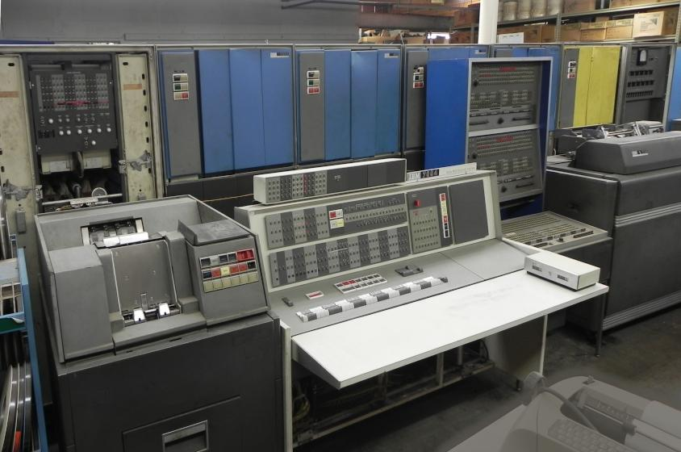
Notes:
This is the IBM 7094, the first multi-user system I am aware of that has software vulnerabilities we’re familiar with.
1962-04-02 IBM 7094 CTSS M1416 UACCNT.SECRET Offline Printing User Passwords Local Disclosure http://osvdb.org/80183
1962-04-02 IBM 7094 CTSS Indirect Instruction Cumulative Time Usage Restriction Bypass http://osvdb.org/80182
1965-01-01 IBM 7094 CTSS Indirect Word Indirect Flag Handling XEC Opcode Local DoS http://osvdb.org/80184
1966-01-01 IBM 7094 CTSS System Text Editor Multiple Instance Password File Local Disclosure http://osvdb.org/23257
http://en.wikipedia.org/wiki/Compatible_Time-Sharing_System
http://www.multicians.org/thvv/7094.html
Image source: http://www.piercefuller.com/library/pan7094.html?id=pan7094
I wanted to use this image:
http://www.gettyimages.com/detail/photo/woman-at-computer-control-panel-1960-high-res-stock-photography/10153785#
Since it was high res and showed a woman working on computers again! But GettyImages said no, I would have to pay $685 to use it. Here is my convo with GettyImages:
http://jerichoattrition.wordpress.com/2013/10/17/any-wonder-why-people-use-images-without-attribution/

Slide 39
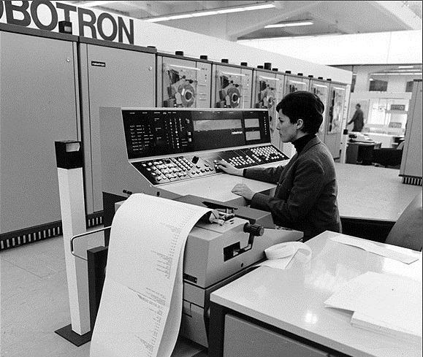
Notes:
Just as the 1960s were not dramatic, the 1970s brought us a world of fun in the vulnerability world!
Yes that says Robotron! No not the arcade game, a computer made by a German company called GDR.
Oh look, women operating computers historically…
Image source: http://germanhistorydocs.ghi-dc.org/sub_image.cfm?image_id=148

Slide 40
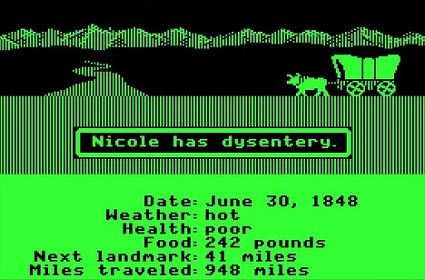
Notes:
Who remembers this wonderful game? Oregon trail!
While not a multi-user game for most of it, you could play it over TTY terminals or the phone line.
It reminds us that even for harmless apps, trusting user input is bad.
1972-01-01 The Oregon Trail Negative Input Money Manipulation http://osvdb.org/97324
Image source: http://latimesblogs.latimes.com/technology/2009/02/oregon-trail-ip.html

Slide 41
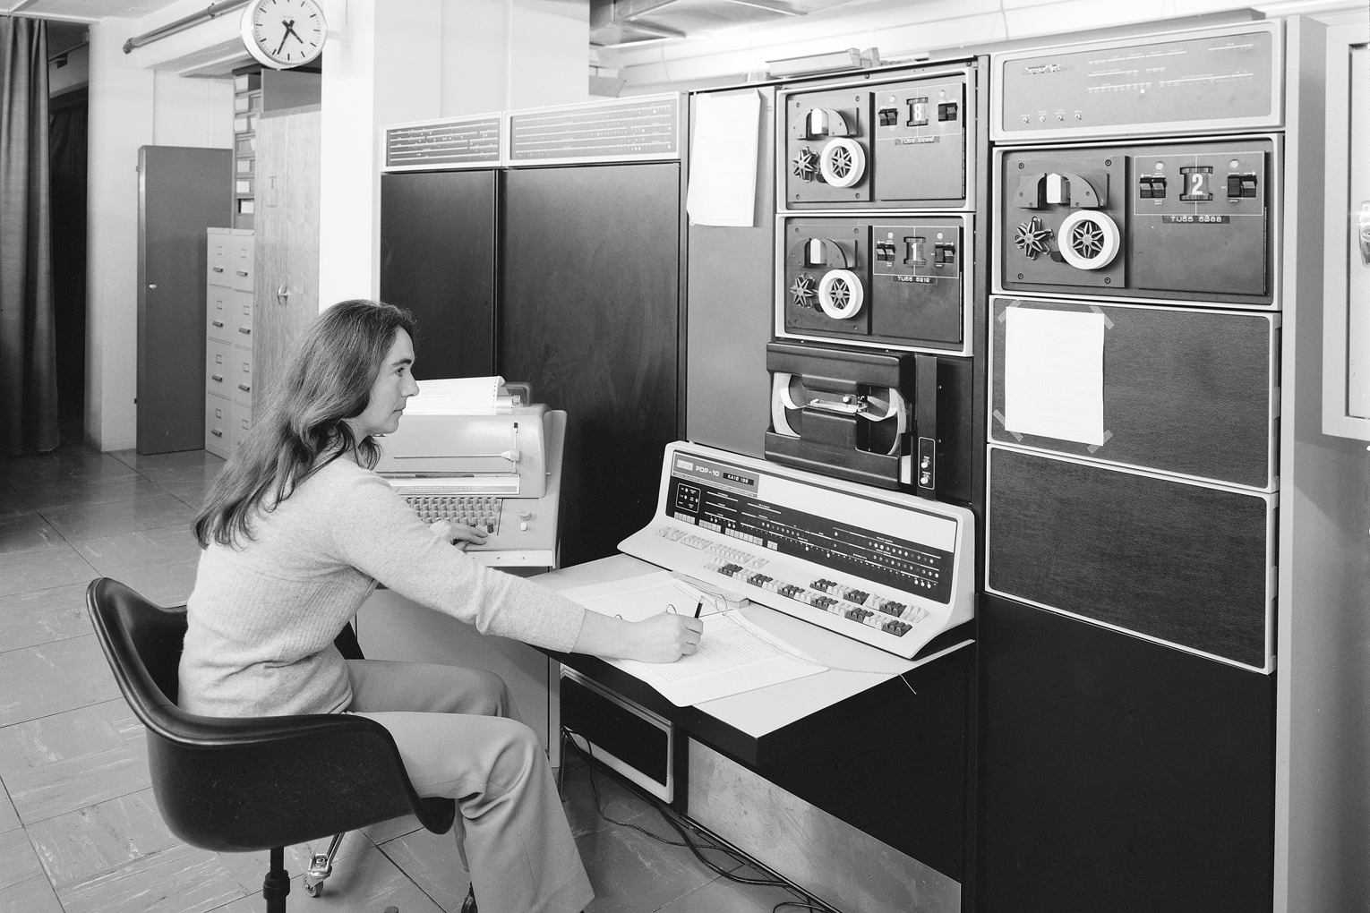
Notes:
This is a PDP-10, manufactured between 1966 and into the 80’s. It ran one of two operating systems, TOPS-10 or TENEX.
In 1972, it was found to have a timing attack vulnerability that allowed a user to figure out another’s password.
PDP-10 Info: http://en.wikipedia.org/wiki/PDP-10
Tcsh Info: http://www.herongyang.com/Computer-History/Tcsh-What-Is-Tcsh.html
Image source: http://cds.cern.ch/record/916840
1972-01-01 TENEX Page Fault Race Condition Password Prediction Weakness http://osvdb.org/23199

Slide 42
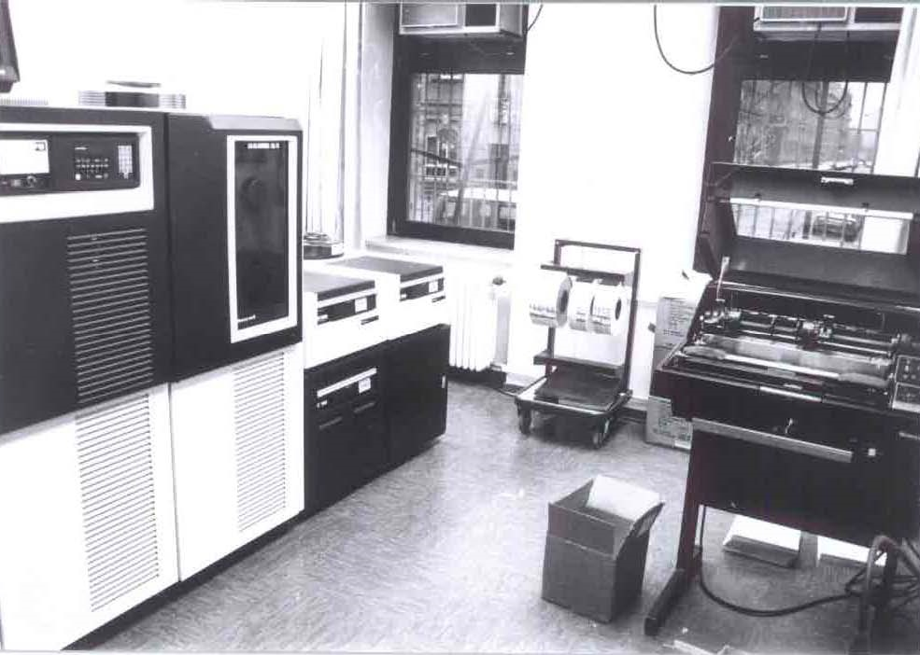
Notes:
This is a Honeywell DPS6 running GCOS-III, or “General Comprehensive Operating System” from GE.
In October, 1972 two vulnerabilities were discovered in it, and another in 1979.
First was a method to abuse the TS FOTRAN compiler to execute commands outside the security envelope.
Second was the File System (FILSYS) module not handling buffers allowing for disclosure of arbitrary user credentials.
Third was unprotected user-accessible memory containing other user passwords.
GCOS Info: http://en.wikipedia.org/wiki/General_Comprehensive_Operating_System
Image source: http://www.teigland.de/19.html
1972-10-01 GCOS-III on HIS 635 TS FORTRAN Assigned GO TO Envelope Bypass http://osvdb.org/22137
1972-10-01 GCOS-III FILSYS Buffer Allocation Information Disclosure http://osvdb.org/22138
1979-01-01 GCOS-III Memory Print Arbitrary Passwords Local Disclosure http://osvdb.org/82445

Slide 43
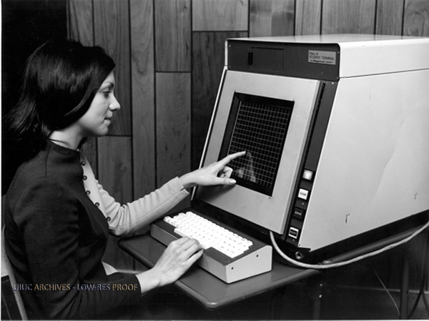
Notes:
The TUTOR programming language was developed for the PLATO IV computer system seen here.
With a crafted ‘ext’ command sent to a remote terminal, could lock it up requiring a power reset to fix.
Info on TUTOR: http://en.wikipedia.org/wiki/TUTOR_(programming_language)
Info on PLATO IV: http://en.wikipedia.org/wiki/PLATO_(computer_system)
Image source: http://web.archive.org/web/20110618184853/http://edudemic.com/2011/04/classroom-technology
Note: Image watermark (UIUC Archive) indicates original point of origin http://www.library.illinois.edu/hpnl/genealogy/uiuc.html
1974-01-01 TUTOR on PLATO IV ext Command Remote DoS http://osvdb.org/66172

Slide 44
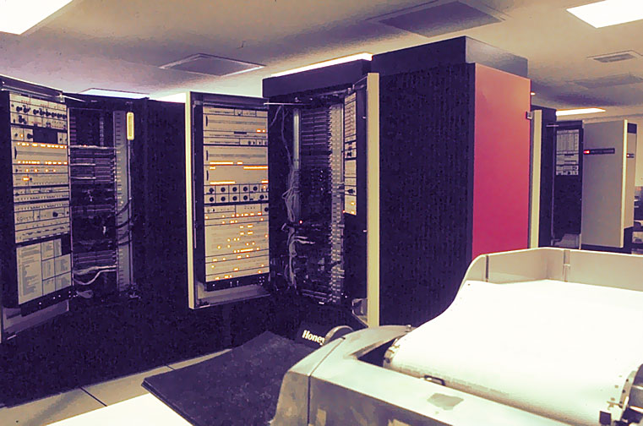
Notes:
MIT’s Honeywell 6180, one of many computers that ran Multics, "Multiplexed Information and Computing Service".
In the 70’s, there were 10 known vulnerabilities in Multics.
Statistically, Multics was kind of the Oracle of the 1970’s.
More info: http://www.multicians.org/security.html
Image source: http://www.multicians.org/features.html
1974-06-01 Multics on HIS 645 mxerror Crafted signaller|0 Local DoS http://osvdb.org/22133
1974-06-01 Multics on HIS 645 Unlocked Stack Base Master Mode Privilege Escalation http://osvdb.org/22134
1974-06-01 Multics on HIS 645 Execute Instruction SDW Access Check Bypass http://osvdb.org/22135
1974-06-01 Multics on HIS 645 Crafted IDC Modifier Privileged Ring Access http://osvdb.org/22136
1974-06-01 Multics on 6180 Call Limiter Gate Segment Failure Privilege Escalation http://osvdb.org/22128
1974-06-01 Multics on 6180 Tally Word Permission Error Login DoS http://osvdb.org/22129
1974-06-01 Multics on 6180 SLT-KS Dual SDW hphcs_ Privilege Escalation http://osvdb.org/22130
1974-06-01 Multics on 6180 Multiple Unspecified Issues http://osvdb.org/22131
1977-01-01 Multics on GE-645 XRAY Facility Arbitrary File Access http://osvdb.org/23345
1979-01-01 Multics Password File Encryption Compromise http://osvdb.org/82446

Slide 45
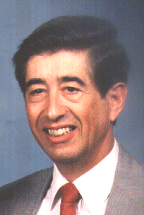
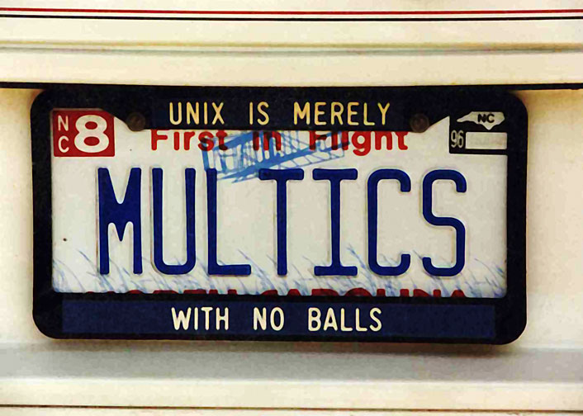
Notes:
Early 1979, Roger R. Schell led a tiger team while at the Naval Postgraduate School (NPS) for the military against the Multics operating system.
During test, they penetrated Multics and modified the manufacturer's master copy of the Multics operating system itself by adding a backdoor.
The backdoor was tiny and required a password for use.
Even after the team told Honeywell that it existed and how it worked, they could not find it.
Instead of looking further and fixing, they just kept distributing Multics, even with the backdoor in place.
More info: http://blog.osvdb.org/2012/06/01/fascinating-vulnerability-and-glimpse-into-33-year-old-pen-testing/
More info: http://www.airpower.maxwell.af.mil/airchronicles/aureview/1979/jan-feb/schell.html
Roger R. Schell bio: http://amcis2005.aisnet.org/schell.htm
82447 1979-01-01 Multics Unspecified Third-party Backdoor
Trap door installed. The tiger team penetrated Multics and modified the manufacturer's master copy of the Multics operating system itself by installing a trap door: computer instructions to deliberately bypass the normal security checks and thus ensure penetration even after the initial flaw was fixed. This trap door was small (fewer than 10 instructions out of 100,000) and required a password for use. The manufacturer could. not find it, even when he knew it existed and how it worked. Furthermore, since the trap door was inserted in the master copy of the operating system programs, the manufacturer automatically distributed this trap door to all Multics installations.

Slide 46
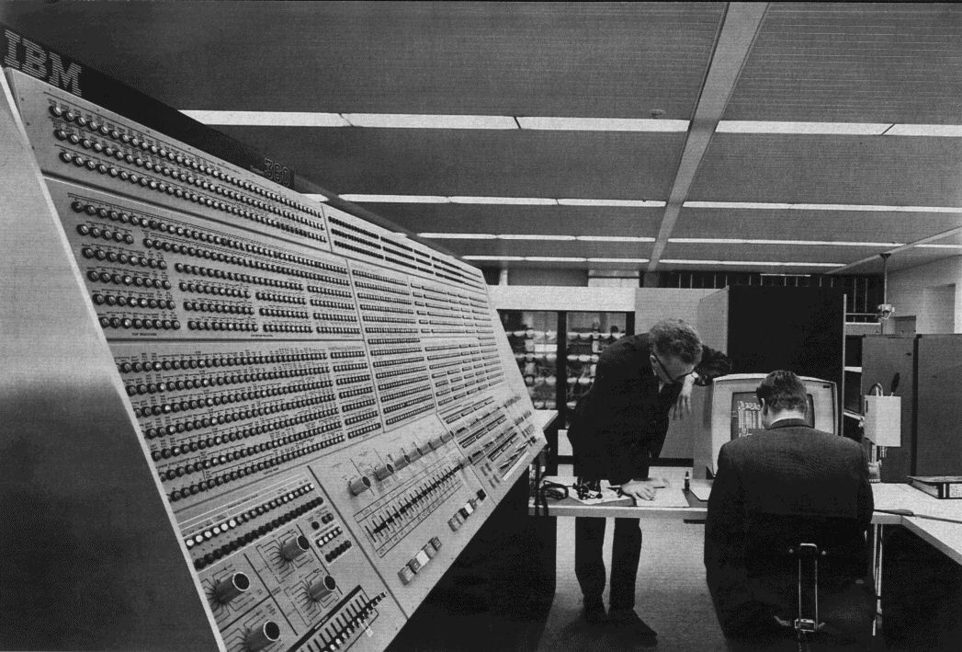
Notes:
This is a Model 91 IBM 360 computer used at NASA. The 360 series ran OS/360 (one of three variants).
In 1974 it was found to have an access restriction bypass vuln in the IMASPZAP utility.
This software is still used today, and the System/360 software is still supported by IBM via the zSeries computers.
More fascinating? 1964 -> 2013 – 49 Years of use, just this one vulnerability found in the original software. Many more in z/OS from 2005 on.
More info: http://en.wikipedia.org/wiki/IBM_System/360#Operating_system_software
Image source: http://upload.wikimedia.org/wikipedia/commons/thumb/9/9e/360-91-panel.jpg/220px-360-91-panel.jpg (Model 91, taken at NASA)
1974-06-01 IBM OS/360 Supplied IMASPZAP Service Aid Access Restriction Bypass http://osvdb.org/22132

Slide 47
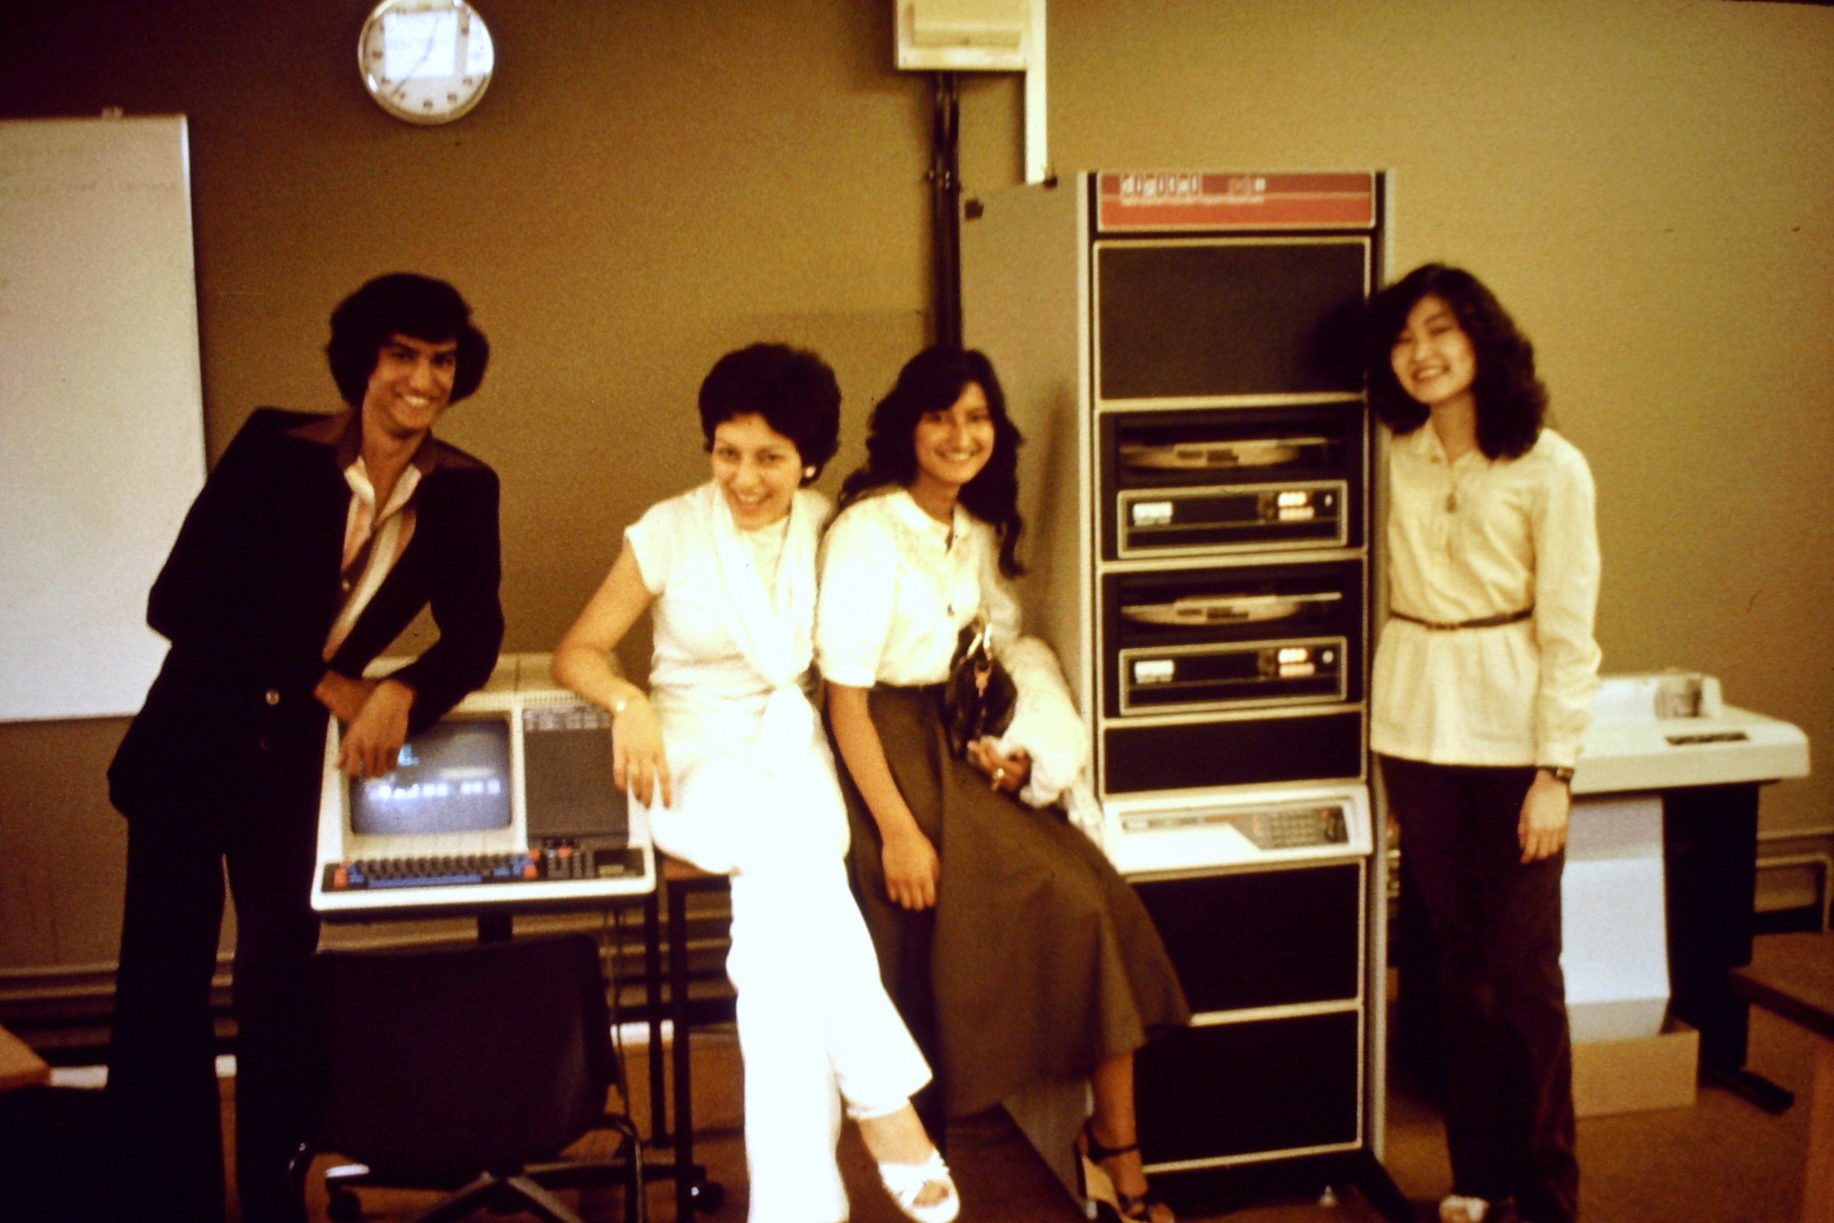
Notes:
This is a PDP-11 at Tottenham College in 1978. RSTS was a multi-user time-sharing OS from DEC for the PDP-11 series.
In 1975, four vulnerabilities were identified in RSTS/E including a DoS, arbitrary user credential disclosure, file disclosure, and an unspecified remote issue with the Login process.
More info: http://en.wikipedia.org/wiki/RSTS/E
Image source: http://emistheblog.wordpress.com/2011/05/21/the-origins-of-femis/
1975-01-01 RSTS/E User TTY Assignment Exhaustion Local DoS http://osvdb.org/67359
1975-01-01 RSTS/E TTY Permission Weakness Arbitrary User Login Credential Disclosure http://osvdb.org/67360
1975-01-01 RSTS/E Record-oriented Access Race Condition File Content Disclosure http://osvdb.org/67361
1975-01-01 RSTS/E Login Process Unspecified Remote Issue http://osvdb.org/67362

Slide 48
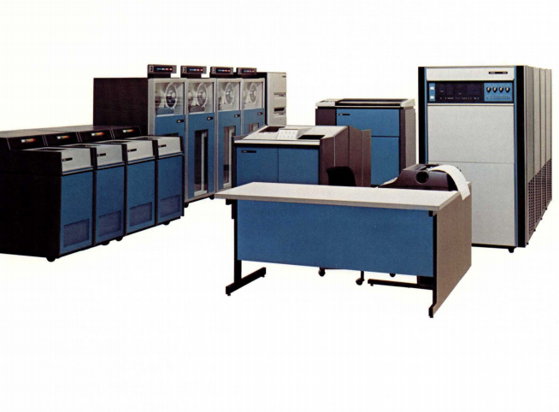
Notes:
This is a Xerox 560, capable of running the CP-V operating system, released in 1973.
In 1975, a vulnerability was found that allowed to a user to bypass the built-in memory protection to elevate privileges.
More info: http://archive.computerhistory.org/resources/access/text/2010/06/102687533-05-03-acc.pdf
More info: http://en.wikipedia.org/wiki/Universal_Time-Sharing_System
Image source: http://bitsavers.trailing-edge.com/pdf/sds/sigma/5xx/560_Flyer_Jan74.pdf
1975-01-01 XEROX CP-V Memory Protection Bypass Local Privilege Escalation http://osvdb.org/88775

Slide 49
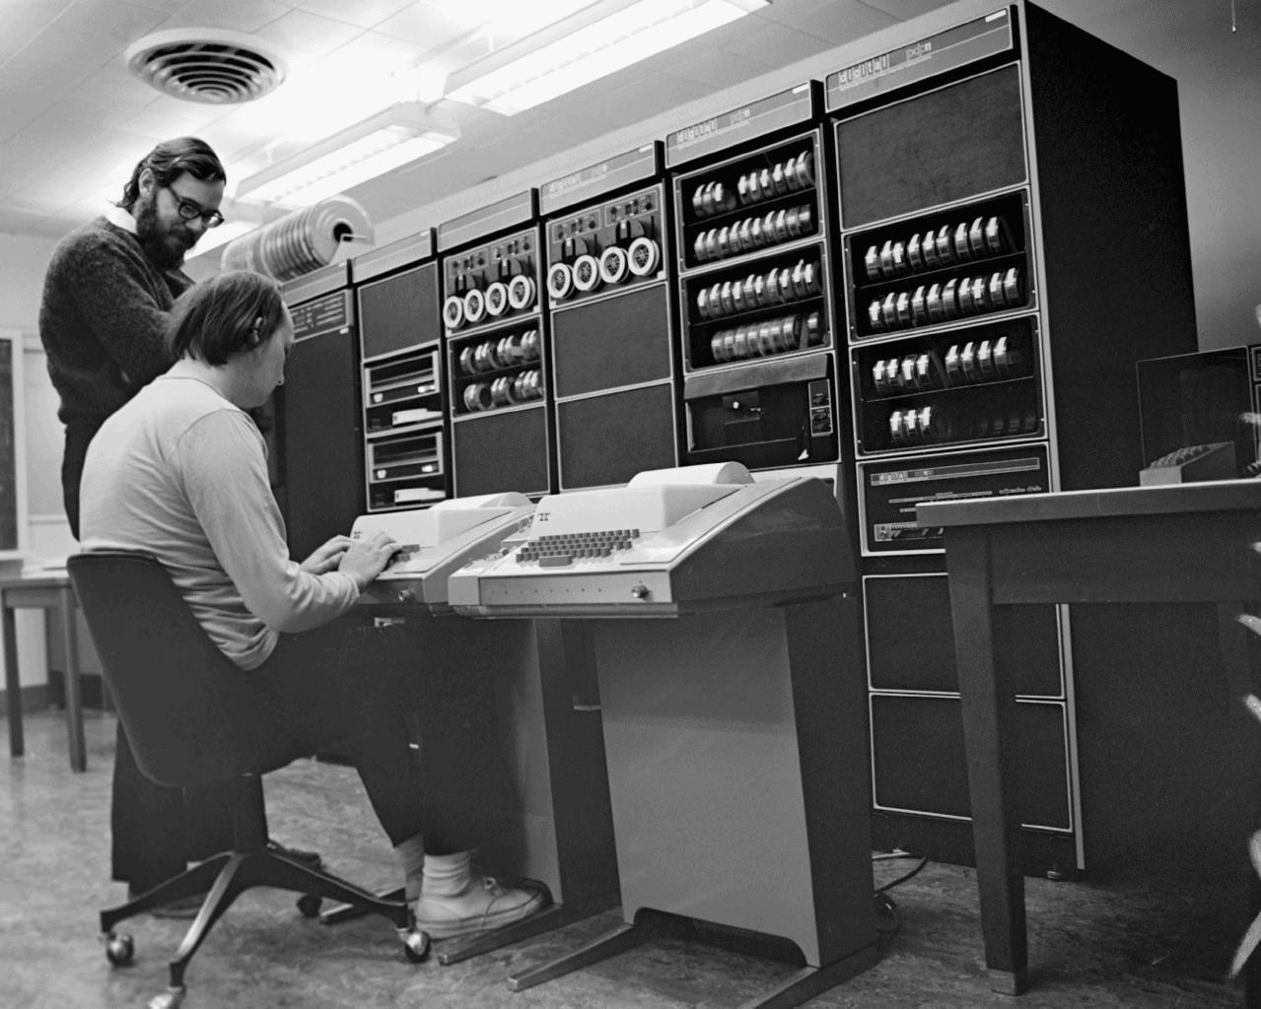
Notes:
This is a PDP-11 as well, and pictured are Dennis Richie and Ken Thompson. These two names should be familiar, as they are modern day computing heroes.
Creators of UNIX, which is not just an operating system but a philosophy, this is the basis for hundreds of subsequent variants including Solaris, AIX, HP-UX, IRIX, BSD, Apple OS X, and Linux.
In 1975, an unspecified vulnerability was found in the login process related to array checking.
Six years later another V6 issue was found in the ‘su’ program, which is arguably when the floodgate opened for Unix vulnerabilities.
Image source: http://www.psych.usyd.edu.au/pdp-11/Images/Images.html / http://www.psych.usyd.edu.au/pdp-11/Images/ken-den_s.jpeg
More info: http://en.wikipedia.org/wiki/Unix / http://en.wikipedia.org/wiki/Version_6_Unix / http://en.wikipedia.org/wiki/Unix_philosophy
1975-05-01 UNIX-V6 login(I) Array Checking Uspecified Issue http://osvdb.org/58015

Slide 50
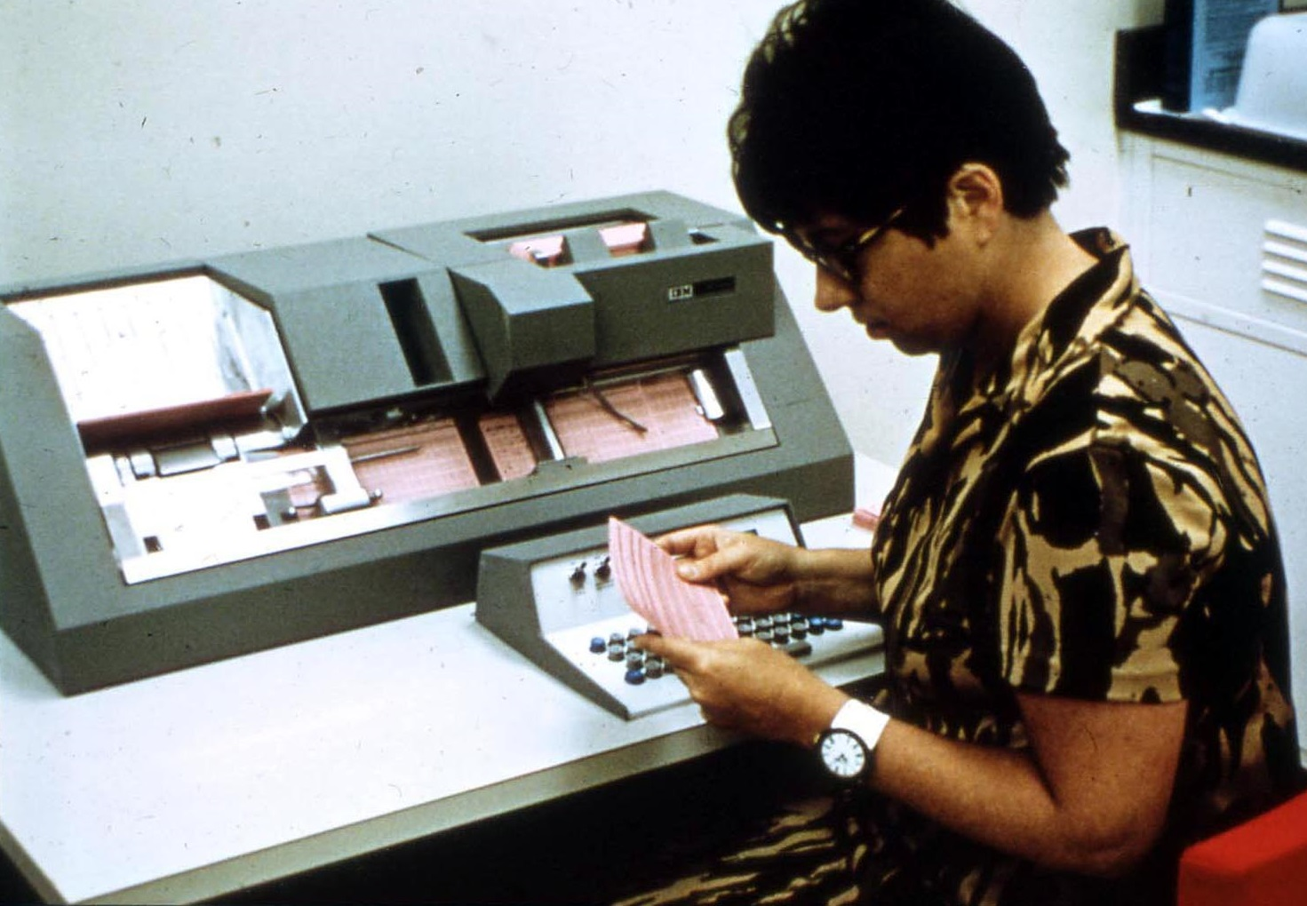
Notes:
This is an IBM 370 punch card system, part of a larger computer system that ran four different operating systems.
Two vulnerabilities were found, one in 1977 for privilege escalation and one in 1979 for password file disclosure.
More info: http://en.wikipedia.org/wiki/IBM_System/370
Image source: http://www.chezfred.org.uk/University/ComputerXHistory/TheIbm370/1974-IBM370-209.htm
1977-01-01 IBM 370 DIAGNOSE Instruction Gain System Privileges http://osvdb.org/3038
1979-01-01 IBM 370 w/ TSO Password File Direct Request Local Disclosure http://osvdb.org/82444

Slide 51
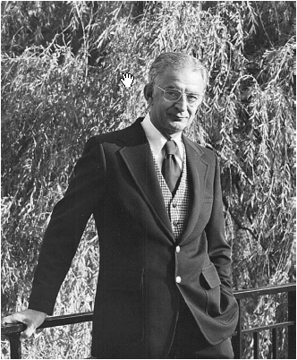
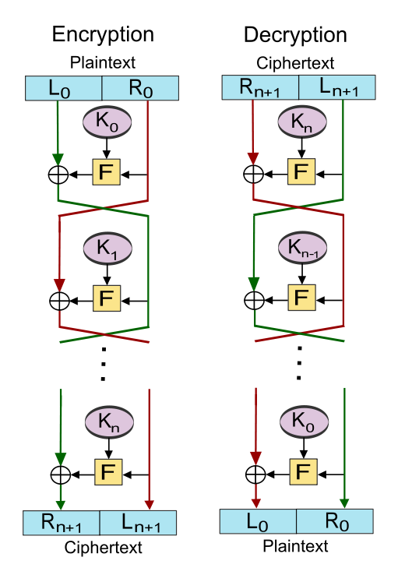
Notes:
New Data Seal (NDS) algorithm, based on Lucifer created by Horst Feistel colleagues at IBM.
Precursor to the Data Encryption Standard, or DES which is still widely used today.
In 1977, NDS was found vulnerable to a “slide attack” that resulted in a full compromise.
This was one of the early computer-based algorithms that fell, and would be one of hundreds including DES.
IBM Logo circa 1972
More info: http://en.wikipedia.org/wiki/Lucifer_(cipher) / http://en.wikipedia.org/wiki/New_Data_Seal / http://en.wikipedia.org/wiki/Data_Encryption_Standard
Image source: http://fistpark.tistory.com/47 / http://en.wikipedia.org/wiki/Feistel_cipher
1977-01-02 New Data Seal (NDS) Algorithm Slide Attack Chosen Plaintext Cryptanalysis Compromise http://osvdb.org/49711

Slide 52
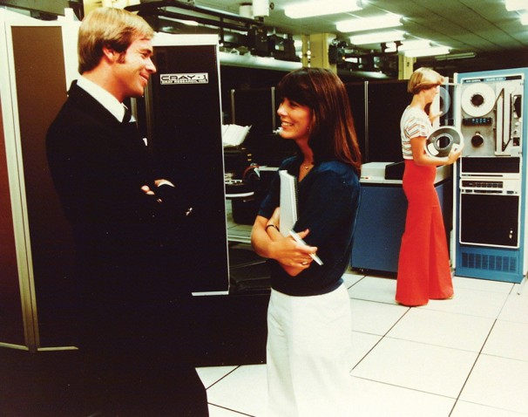
Notes:
So from here we get into a slightly more modern security world. Vulnerabilities were surfacing enough in the 70’s so it was a concern to some (e.g. military).
Remember, many back then were not security people, as there were few dedicated to that task, but admins were expected to secure their systems.
By the 80’s, vulnerabilities were becoming more prevalent, to the point some decided a list of them should be maintained.
Those first lists were the early vulnerability databases. Different than today’s, but the same intent and goal. Catalog all the vulns.
Before the 80’s, the original VDB was likely the “Repaired Security Bugs in Multics” from 1973. For a vulnerability historian, this is kind of a holy grail and I am close to getting it!
Image source: 1970’s NSA via http://www.washingtonpost.com/national/on-innovations/a-history-of-the-nsa/2013/06/19/ded58b8a-d823-11e2-a9f2-42ee3912ae0e_gallery.html#photo=23

Slide 53
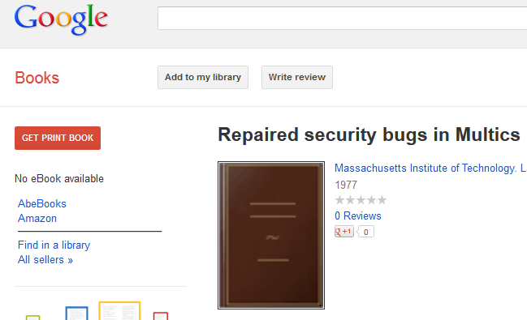
Notes:
This vulnerability list was eventually put into book format apparently, printed in 1977. 0 reviews, come on!
So obviously I wanted to ‘get print book’ in order to review it. And integrate any missing vulns into OSVDB.

Slide 54
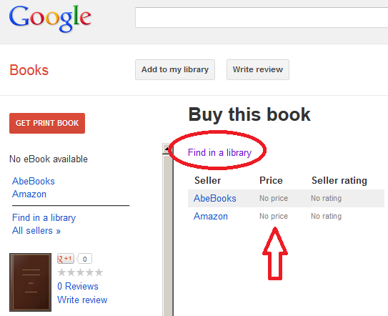
Notes:
Great, Google fails to find a copy. Not even in the Amazon market!
But look, I can find it in a library!

Slide 55
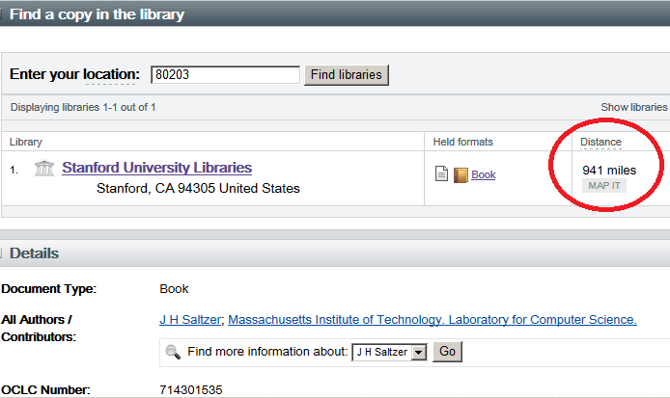
Notes:
It exists in one library according to Google books, and it is 941 miles away. In California. No one wants to go to California.
So of course this prompts my logical, reserved response…

Slide 56
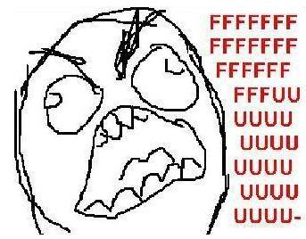
Notes:
Yeah, not happy. Fortunately, I may have a line on getting a copy in just a week or so via a sympathetic professor at UPenn.
My fingers are crossed.

Slide 57
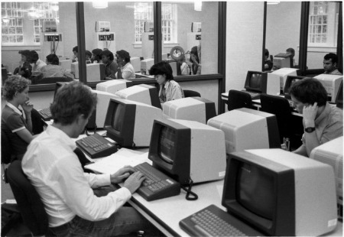
Notes:
The 1980’s are a more familiar time for us. Computers are smaller, and more importantly, prevalent.
After the “Repaired Security Bugs in Multics” you have more efforts to catalog vulnerabilities in the 1980s.
This came in two forms: mail lists that catered to security discussion including vulns, and concise lists of vulns.
I’m switching tracks briefly here from specific vuln types and specific technology to the fact that there were starting to be so many, they had to be cataloged.
Image source: http://www.alumniblog.ncsu.edu/2010/08/17/library-exhibit-celebrates-50-years-of-pams/

Slide 58
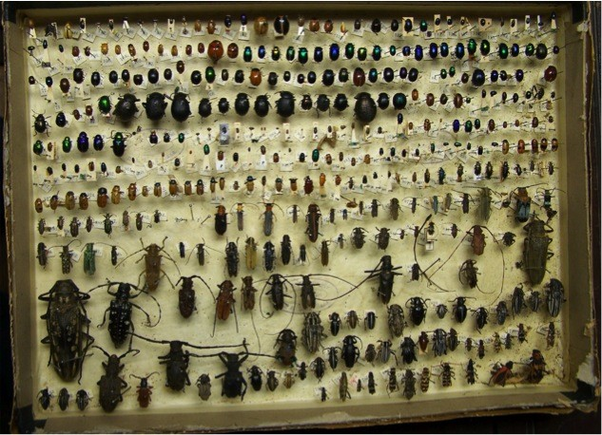
Notes:
If that wasn’t a warning sign, I don’t know what is.

Slide 59
Notes:
After the Multics list, in the mid to late 80’s we saw several other people attempt to catalog vulnerabilities, or centralize discussion on them.
This came in the form of the Unix 'Security Mailing List‘ in 1984 by Lyle McElhaney (not pictured), Matt Bishop's UNIX Hole List in 1985, the Rutgers mail list in 1985 by Al Walker, the Phage mail list in 1988 by Gene Spafford, and the Zardoz mail list in 1989 by Neil Gorsuch.
There were also other vulnerability lists but details are fuzzy, I am still working on tracking these down. These include The Unix Known Problem List, UC Santa Cruz hack method list, Sun Microsystems Bug-List (internal), and more.
Image source: http://www.linkedin.com/pub/neil-gorsuch/8/9bb/63a (Neil Gorsuch), http://www.csmonitor.com/Innovation/Responsible-Tech/2008/0611/squeezing-the-most-out-of-a-gallon (Al Walker), http://nob.cs.ucdavis.edu/bishop/ (Matt Bishop), and http://about.me/spaf (Gene Spafford)
Mail list archives: http://securitydigest.org/unix/ http://securitydigest.org/rutgers/ http://securitydigest.org/phage/ http://securitydigest.org/zardoz/

Slide 60
Notes:
By this point there were dozens of books on security, Unix and VMS boxes all over, the early years of the Internet, and a changing mindset where things were increasingly networked.
This gave access to additional computers you couldn’t otherwise interact with.
This also gave curious types (i.e. hackers) the ability to poke around your system.
Yes, in 1987 that was the entire Internet in one relatively simple graphic!
1987 BBN Internet Map
Image source: http://www.computerhistory.org/internet_history/internet_history_80s.html

Slide 61
Notes:
Even the home PCs were starting to run Bulletin Board Systems (BBS) more frequently, which had their own vulnerabilities.
Dialup access was just as good as a network for accessing, and compromising, remote systems.
By this point, security starts to take hold in people’s minds.
Image source: http://bloggingtom.ch/archives/2006/01/30/good-old-bbs/
More info: http://tinyurl.com/bbs-vulns or
http://osvdb.org/search/search?search%5Bvuln_title%5D=bbs&search%5Btext_type%5D=titles&search%5Bs_date%5D=1970-01-01&search%5Be_date%5D=1995-01-01&search%5Brefid%5D=&search%5Breferencetypes%5D=&search%5Bvendors%5D=&search%5Bcvss_score_from%5D=&search%5Bcvss_score_to%5D=&search%5Bcvss_av%5D=*&search%5Bcvss_ac%5D=*&search%5Bcvss_a%5D=*&search%5Bcvss_ci%5D=*&search%5Bcvss_ii%5D=*&search%5Bcvss_ai%5D=*&kthx=search

Slide 62
Notes:
The late 70’s early 80’s gave us a new look at Denial of Service (DoS) attacks.
Unlike the DoS attacks we’re familiar with now, based on saturating a connection or sending magic packets a system can’t handle..
These attacks were based on physical sabotage. Either via bombs or arson, people would destroy computer systems for a variety of reasons.
Sometimes simple revenge from a jilted employee. Other times, activist or terrorist groups.
The logo above is for Le Comité pour la Liquidation Ou la Destruction des Ordinateurs (CLODO), who attacked Univac, Honeywell, and others.
More info: https://www.facebook.com/pages/CLODO/299982560929?v=info and http://www.processedworld.com/Issues/issue10/i10clodo.htm
Image source: http://www.processedworld.com/Issues/issue10/i10clodo.htm
For a fun read on 1800’s DoS attacks against cables: http://www.history.com/this-day-in-history/griersons-raid-cuts-telegraph-wires-near-macon and http://research.archives.gov/description/519420

Slide 63
Notes:
The 70’s and 80’s also gave us our first taste of SCADA vulnerabilities, despite the next SCADA vuln being published a full 17 years later in 2001.
Note that while the first publication was in 1983, the problem had been around a while.
Image source: http://www.morguefile.com/archive/display/96358
1983-12-20 Nuclear Power Plant Portable Radio Transmitter Interference Arbitrary System Shutdown DoS http://osvdb.org/86573

Slide 64
Notes:
Historically, the first incident occurred at the Farley nuclear plant in Alabama, in 1975. They figured out the Differential Relay Type 12 STD 15B5A is “radio frequency sensitive”.
Think about that; a standard walkie talkie could shut down critical systems at a nuclear power plant. Let that sink in.
The second example happened at Sequoyah nuclear plant in Tennessee, in May of 1979. A tech’s walkie talkie sent a spurior signal to all four channels of a pressurizer initiating a safety injection.
The third example happened at Three Mile Island in Pennsylvania, in Feb of 1982. Workers carrying combustible gas monitors indicated air that wasn’t friendly for breathing. The cause? Their face mask radios.
The fourth example occurred at Grand Gulf in Mississippi in July of 1983, where a shutdown cooling loop was lost for 30 minutes.
Does it scare you more that a simple walkie-talkie caused this many problems at four nuclear power plants, or that the Nuclear Regulatory Commission figured it out and issued an advisory 8 years after the first incident?
The vulnerability was re-discovered at the Davis-Besse nuclear power plant in March, 2011, losing its emergency water cooling system for two minutes.
Image source: http://www.morguefile.com/archive/display/96358
1983-12-20 Nuclear Power Plant Portable Radio Transmitter Interference Arbitrary System Shutdown DoS http://osvdb.org/86573

Slide 65
Notes:
Now we’re up to the 1990s, and this really is the rise of the vulnerabilities.
The 90’s saw more mail lists like Bugtraq, comprehensive vulnerability databases like ISS X-Force, and the creation of a standard for vulnerability identifiers like CVE.
The 90’s had 2,366 documented vulnerabilities, and in reality, thousands more that never made it into vulnerability databases. But I’m working on that…
This is also why I don’t think graphs work for this presentation.

Slide 66
Notes:
Because I see that graph and want to fill in pretty colors…

Slide 67
Notes:
Or play tic-tac-toe, even if I lose to a chicken. Anyway….

Slide 68
Notes:
Up to 1994 you saw primarily Unix-based vulnerabilities, both local and remote.
Encryption algorithms like GDES, Snefru, Khafre, REDOC-II, LOKI, and Lucifer were falling like flies. Yes, encryption algorithms have cool names.
Image source: https://www.its.uq.edu.au/about-its/history-computing-uq

Slide 69
Notes:
1994 hits, and Pandora’s box opens.
Image source: http://www.buzzfeed.com/catsparella/the-best-maru-moments-of-2010-1ruv
Maru info: http://en.wikipedia.org/wiki/Maru_(cat)
Maru videos: http://www.youtube.com/user/mugumogu

Slide 70
Notes:
With the commercialization of the web and more rapid deployment, we saw an eternal fountain of web-based vulnerabilities.
Over the next 15 years we’d see yearly vulnerability counts jump considerably as a result.
BTW, this is the first web server ever.
Note that 1994 is my somewhat arbitrary date based on perception of web server/page availability during my early Internet days, and Mosaic/Netscape becoming a commercial endeavor between Aug 1993 and April 1994.
More info: http://en.wikipedia.org/wiki/Web_server
Image source: http://en.wikipedia.org/wiki/File:First_Web_Server.jpg

Slide 71
Notes:
The turn of the century saw a frequently changing landscape.
Vulnerability research and disclosure matured greatly, but we also saw a steady stream of crap.
Image source: This thing is on a dozen+ stock photography sites, uploaded by various ‘members’. No way that many people have copyright. I spent 15 minutes trying to track down the original image and had no luck.

Slide 72
Notes:
2006 saw the great spike of XSS and SQLi as a result.
The quality of disclosures varied greatly, but there were so many inaccurate reports (meaning they are flat out wrong), we have to track them on OSVDB as “myth / fake”.
We currently have 436 disclosures flagged like this, and honestly, there are probably closer to a couple thousand.
Image source: Jurassic Park

Slide 73
Notes:
We learned anyone can be a “security researcher” by plugging in some script code or a back tick.
Disclosures had no vendor URL, no version, sometimes no script name, but dammit, they were a security researcher!
Image source: Local collection (this thing is ancient)

Slide 74
Notes:
We also saw vulnerabilities disclosed in systems that may seem more ‘obscure’, but in reality may have more impact on us long term.
Between 2004 and 2009, this included electronic voting machines from Premier Election Systems (aka Diebold), Hart, Election Systems & Software (ES&S), Sequoia, and Digivote.
Image source: Whitney Curtis, http://usatoday30.usatoday.com/news/opinion/editorials/story/2012-09-19/electronic-voting-fraud-security/57809062/1
Electronic voting machine vulns: http://tinyurl.com/evoting-vulns or
http://osvdb.org/search/search?search%5Bvuln_title%5D=electronic+voting&search%5Btext_type%5D=alltext&search%5Bs_date%5D=&search%5Be_date%5D=&search%5Brefid%5D=&search%5Breferencetypes%5D=&search%5Bvendors%5D=&search%5Bcvss_score_from%5D=&search%5Bcvss_score_to%5D=&search%5Bcvss_av%5D=*&search%5Bcvss_ac%5D=*&search%5Bcvss_a%5D=*&search%5Bcvss_ci%5D=*&search%5Bcvss_ii%5D=*&search%5Bcvss_ai%5D=*&kthx=search

Slide 75
Notes:
Vulnerabilities were identified in various automobiles including ways to bypass the keyless entry systems, including BMWs.
Automobile vulns: http://tinyurl.com/auto-vulns or http://osvdb.org/search/search?search%5Bvuln_title%5D=automobile&search%5Btext_type%5D=alltext&search%5Bs_date%5D=&search%5Be_date%5D=&search%5Brefid%5D=&search%5Breferencetypes%5D=&search%5Bvendors%5D=&search%5Bcvss_score_from%5D=&search%5Bcvss_score_to%5D=&search%5Bcvss_av%5D=*&search%5Bcvss_ac%5D=*&search%5Bcvss_a%5D=*&search%5Bcvss_ci%5D=*&search%5Bcvss_ii%5D=*&search%5Bcvss_ai%5D=*&kthx=search

Slide 76
Notes:
It was also disclosed that some newer Ducati motorcycles that had a small onboard computer had a keyless system.
You could start the bike if you knew the 4-digit code. The default 4-digit code…
Image source: https://web.archive.org/web/20101205050342/http://www.cyclenews.com/files/news_articles/industry/1110/30_Diavel_Carbon.jpg and http://arizonafoothillsmagazine.com/autos/wp-content/uploads/2011/03/2011-Ducati-Diavel-Diamond-Black-phoenix-arizona-valley-scottsdale.jpg
2011-04-05 Ducati Diavel Motorcycle Default Ignition Password http://osvdb.org/75811

Slide 77
Notes:
Also in the ‘scary’ realm, we started seeing more disclosures in medical devices.
This is actually a Therac-25 which had an issue back in 1985 where a small race condition may have causes a potentially lethal radiation overdose. Oops.
Medical vulns: http://tinyurl.com/medical-vulns or
http://direct.osvdb.org/search/search?search%5Bvuln_title%5D=medical&search%5Btext_type%5D=alltext&search%5Bs_date%5D=&search%5Be_date%5D=&search%5Brefid%5D=&search%5Breferencetypes%5D=&search%5Bvendors%5D=&search%5Bcvss_score_from%5D=&search%5Bcvss_score_to%5D=&search%5Bcvss_av%5D=*&search%5Bcvss_ac%5D=*&search%5Bcvss_a%5D=*&search%5Bcvss_ci%5D=*&search%5Bcvss_ii%5D=*&search%5Bcvss_ai%5D=*&kthx=search

Slide 78
Notes:
And that brings us to this decade. What are we seeing? Everything.
All of the old classics we have come to love or loathe.
While there are some exciting new devices as more of our lives are filled with gadgets that must be connected, the vulns are basically the same.

Slide 79
Notes:
2011 and later gave us the rise of bug bounty programs.
While several bounties had been operating for many years, many companies and online services started their own, seeing the incredible value.
What used to fetch thousands of dollars now commands six figures in some cases.
Image source: http://www.geeky-gadgets.com/facebook-bug-bounty-numbers-04-08-2013/

Slide 80
Notes:
Speaking of money, if I had a nickel for every vulnerability ever disclosed, I’d have a shit load of nickels.
In reality, OSVDB will hit the 100,000 mark on cataloged vulnerabilities by the end of this year.
Image source: http://www.chinasmack.com/2013/pictures/bank-employees-spend-all-day-counting-10000-rmb-in-coins.html

Slide 81
Lessons Learned
Notes:
The obvious lesson is that vulnerabilities are not new by any stretch of the imagination.
The last 110 years have shown us, repeatedly, that hardware and software is vulnerable.
Cleartext transmissions from 1902, Crypto failure since 1939, trusting user input since 1955, race conditions since 1956…
Overflows since 1983, uncontrolled format strings since 1998, SQL injection since 1998, cross-site scripting since 1999…
Despite that incredible history, here we are, still suffering from the same vulnerabilities over and over. Why?
Image source: http://www.tineye.com/search/950c7103b8b304e93dbcd63ecd219f42bdb15c10/?pluginver=chrome-1.1.3 Used all over, no clear source.

Slide 82
Notes:
Quite simply, because we aren’t addressing the underlying problem. Instead…

Slide 83
Notes:
We keep putting bandaid solutions on top of older bandaids, desperately trying to plug a hole of the sinking ship.
Rather than fix the issues at the root, we continue to come up with new, exciting, and profitable ways to fix the symptoms.
Image source: http://listsoplenty.com/blog/?p=9338

Slide 84
Notes:
If it has more blinky lights and colorful buzzwords, it will better protect us!
Will your cloud-based DLP protect you from the BYOD threat, or be a stomping ground for the latest APT? Oh my.

Slide 85
Notes:
As a security industry, we sell degenerate solutions that treat symptoms, not cure the disease.
We go to security conferences and preach to the choir, talking about the next best thing and magical solutions.
But any real solutions are lost in the echo chamber.
Ultimately, the security industry is a lot like these fine folks above, and we know how productive they are.

Slide 86
Notes:
We spend countless hours debating “full disclosure” and how much time to give vendors to fix a reported vulnerability.
All the while, many vendors including some of the biggest, drag their feet and take as many as 3 years to fix simple issues.
Even after an issue is disclosed.
Image source: http://www.despair.com/apathy.html

Slide 87
Notes:
The age-old question is “How do we fix this?”
I’m more of a breaker than a builder, so this isn’t exactly my brand of cola.
All these “smart” vendors with “industry leading” whatever; Shouldn’t they actually be fixing the problem?
Need depression? https://www.cerias.purdue.edu/site/blog/post/happy_anniversary_--_bang_my_head_against_a_wall/
Image source: http://hivizme.wordpress.com/2012/06/29/accl-enter-the-premier-league-of-network-cabling/

Slide 88
Notes:
All I can offer you is perspective and a small dose of reality.
Image source: http://www.break.com/pictures/wha-happened-2178789 (and hundreds of other blogs)

Slide 89
Questions?

Slide 90
Thanks:
Mar for awesome graphics
OSF and RBS for providing resources to do the research
Towne/Nickerson/Hutton for inspiration to tell a story
Countless people that were around “back then” to give me info, pointers, and perspective
Janice and BSidesDE for venue
You! For listening.

